Slide 1
DNA REPLICATION II

Slide 2
EUKARYOTIC DNA SYNTHESIS IS SIMILAR TO
SYNTHESIS IN PROKARYOTES, BUT MORE
COMPLEX
IN EUKARYOTIC CELLS:
there is more DNA than prokaryotic cells
the chromosomes are linear
the DNA is complexed with proteins

Slide 3
MULTIPLE REPLICATION ORIGINS
BIDIRECTIONAL DNA SYNTHESIS

Slide 4
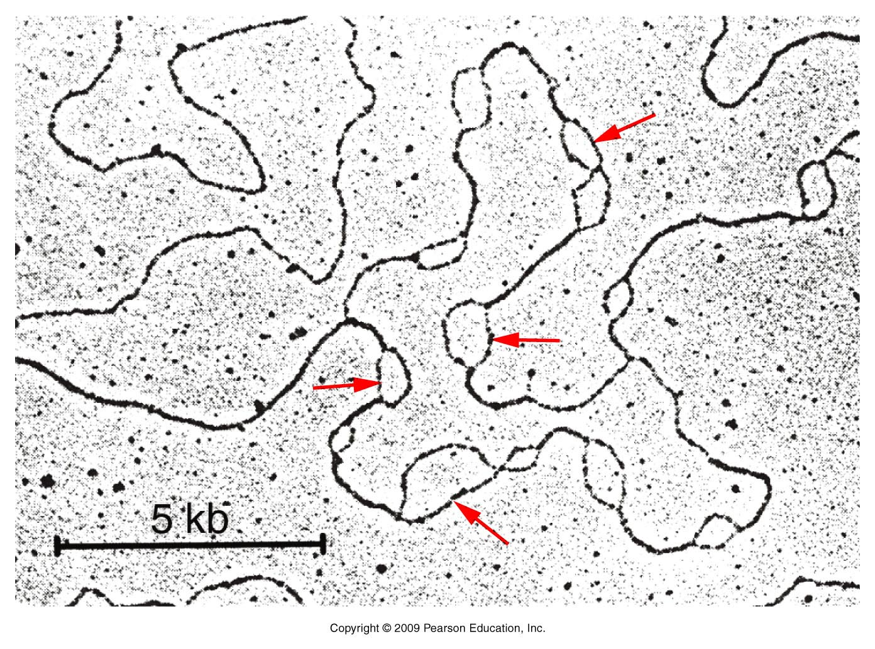
EUKARYOTIC CHROMOSOMES CONTAIN MULTIPLE
ORIGINS OF REPLICATION TO ALLOW THE GENOME
TO BE REPLICATED IN A FEW HOURS

Slide 5
MULTIPLE REPLICATION ORIGINS
IS ESSENTIAL FOR THE COMPLETE GENOME
TO BE REPLICATED IN A REASONABLE TIME
THERE ARE DIFFERENT NUMBER OF
REPLICONS PER GENOME
Ex: Yeast (S. cerevisiae) has 250-400 replicons
Mammalian cells have 25.000 replicons
REPLICATION ORIGINS ARE CALLED AS
AUTONOMOUSLY REPLICATING SEQUENCES
(ARSs)

Slide 6
ALL ARSs ARE INITIALLY BOUND BY A
GROUP OF SPECIFIC PROTEINS WHICH
IS CALLED AS ORIGIN RECOGNITION
COMPLEX (ORC)
THESE COMPLEXES ARE FORMED IN G1
PHASE OF CELL CYCLE BEFORE S PHASE
CELL CYCLE CONTROL PROTEINS
(KINASES) ARE ACTIVATED AND BIND TO
ORCs, WHICH CAN BE ACCESSED BY DNA
POLYMERASES

Slide 7
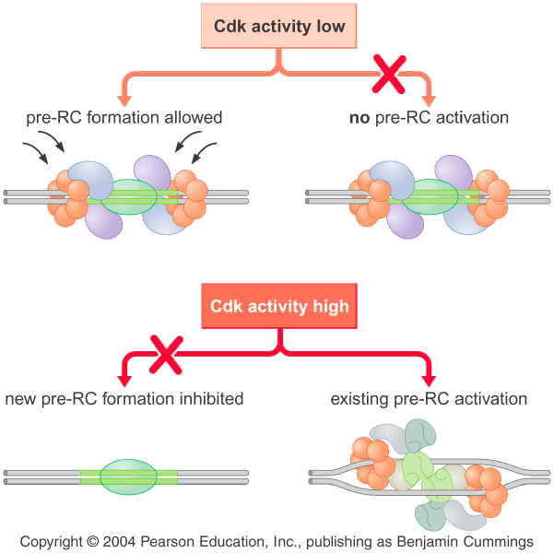
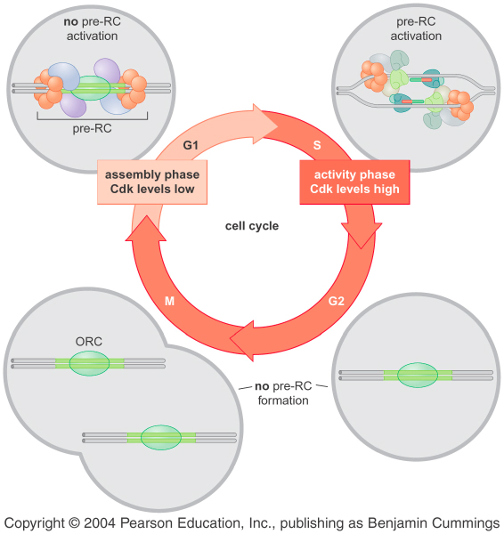

Slide 8
THE ACTIVATION INHIBITS REFORMATION
OF THE PREREPLICATION COMPLEX
ONCE DNA SYNTHESIS HAS BEEN
COMPLETED AT EACH REPLICON
THIS MECHANISM ENSURES THAT
REPLICATION ONLY OCCURS ONCE
ALONG EACH STRECH OF DNA DURING
CELL CYCLE

Slide 9
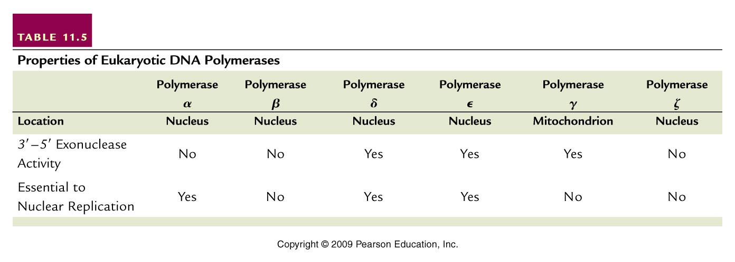
EUKARYOTIC DNA POLYMERASES
3 DNA POLYMERASES ARE INVOLVED IN
REPLICATION OF NUCLEAR DNA
1 INVOLVES MITOCHONDRIAL DNA REPLICATION
OTHERS ARE INVOLVED IN REPAIR PROCESSES

Slide 10
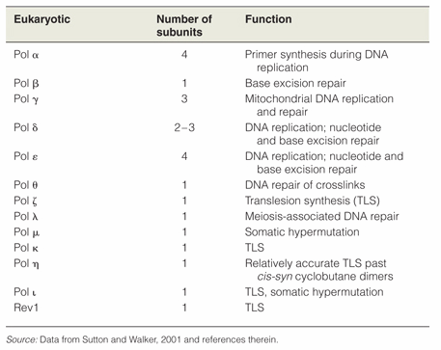

Slide 11
Pol α and δ
MAJOR FORMS OF THE ENZYME INVOLVED IN INITIATION AND ELONGATION
Pol α
POSSESSES LOW PROCESSIVITY
FUNCTIONS IN SYNTHESIS OF RNA PRIMERS DURING INITIATION ON THE LEADING AND LAGGING STRANDS
Polymerase switching occurs
Pol α IS REPLACED BY Pol δ, WHICH HAS HIGH PROCESSIVITY FOR ELONGATION

Slide 12
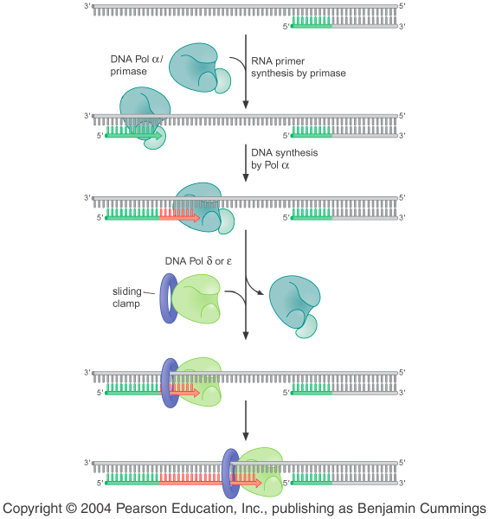
DNA Polymerase Switching

Slide 13
TO ACCOMODATE THE INCREASED NUMBER
OF REPLICONS, EUKARYOTIC CELLS CONTAIN
MANY MORE DNA POLYMERASE MOLECULES
THAN BACTERIA
Ex: E. coli has 15 copies of DNA polymerase III
per cell while, animal cells contain 50.000
copies of α-DNA polymerase

Slide 14
THE PRESENCE SEVERAL NUMBERS OF
REPLICONS WITH SMALLER SIZES (100-150
nucleotides) COMPENSATES FOR THE SLOWER
RATE OF DNA SYNTHESIS IN EUKARYOTES
Ex: E. coli NEEDS 20-40 MINUTES TO
REPLICATE ITS CHROMOSOME WHILE
Drosophila (with 40 times more DNA) NEEDS
3 MINUTES TO COMPLETE THIS TASK

Slide 15
TELOMERES PROVIDE STRUCTURAL
INTEGRITY AT CHROMOSOME ENDS
BUT ARE PROBLEMATIC TO REPLICATE
TELOMERES AT THE ENDS OF LINEAR
CHROMOSOMES CONSIST OF LONG STRETCHES
OF SHORT REPEATING SEQUENCES AND
PRESERVE THE INTEGRITY AND STABILITY OF
CHROMOSOMES

Slide 16
EUKARYOTIC CHROMOSOMES END IN DISTINCTIVE
SEQUENCES CALLED AS TELOMERES
THESE SEQUENCES CONSIST OF SHORT TANDEM
REPEATING SEQUENCES “TTGGGG”
Ex: IN HUMAN CHROMOSOMES 5’-TTAGGG-3’
SEQUENCE IS REPEATED SEVERAL TIMES AT
THE ENDS “G” RICH STRANDS OF THE
CHROMOSOMES
THE G- RICH SINGLE STRANDED TAILS CAN LOOP
BACK IN THEMSELVES AT THE CHROMOSOME
ENDS CALLED AS T-LOOPS (TELOMERE LOOPS)

Slide 17
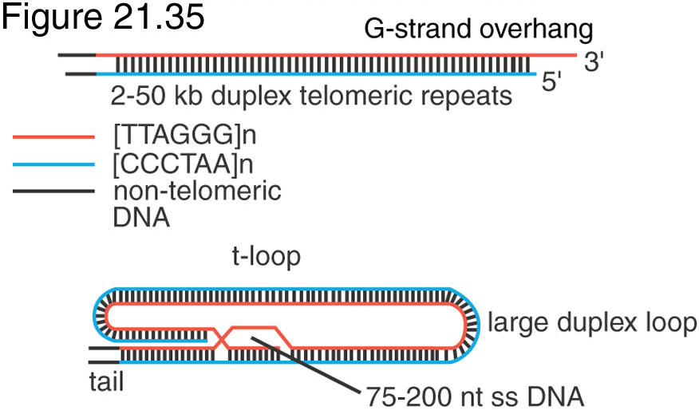
Telomeres protect chromosome ends

Slide 18
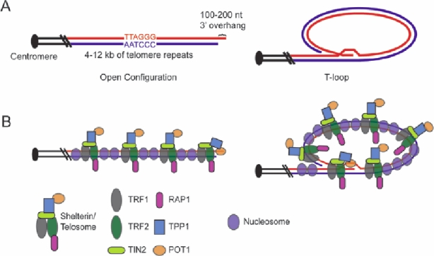
T-Loop in Telomeres

Slide 19
TELOMERIC SEQUENCES HAVE HEXANUCLEOTIDE
OR HEPTANUCLEOTIDE REPEATING SEQUENCES
AFTER EACH REPLICATION ONE STRAND IN EACH
CHROMOSOME ENDS HAVE 12-16 NUCLEOTIDES
LONG OVER HANG, THIS IS ON THE ‘G’ RICH 3’ENDING

Slide 20
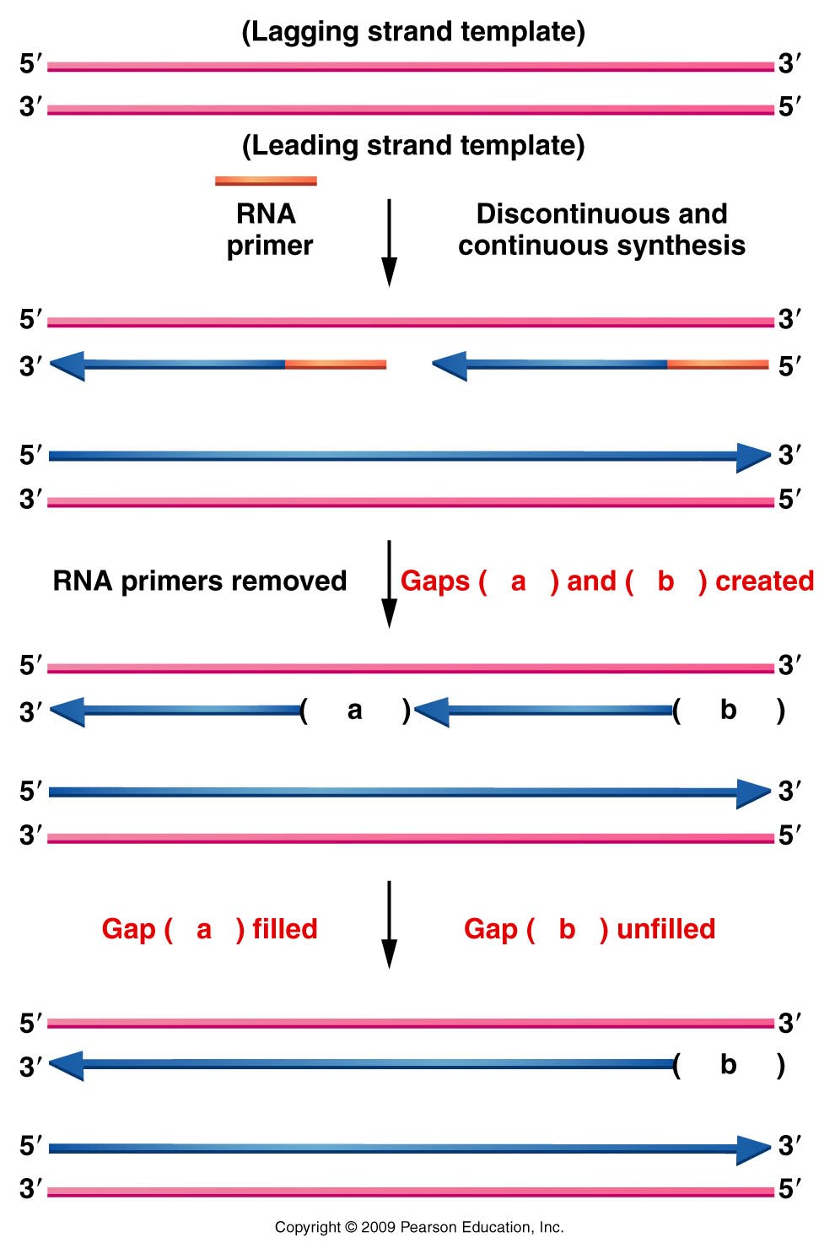
REPLICATION AT THE
TELOMERE
LAGGING STRAND
SYNTHESIS AT END OF
CHROMOSOME IS A
PROBLEM ONCE THE
RNA PRIMER IS
REMOVED, THERE IS
NO FREE 3'-HYDROXYL
GROUP FROM WHICH
TO ELONGATE

Slide 22
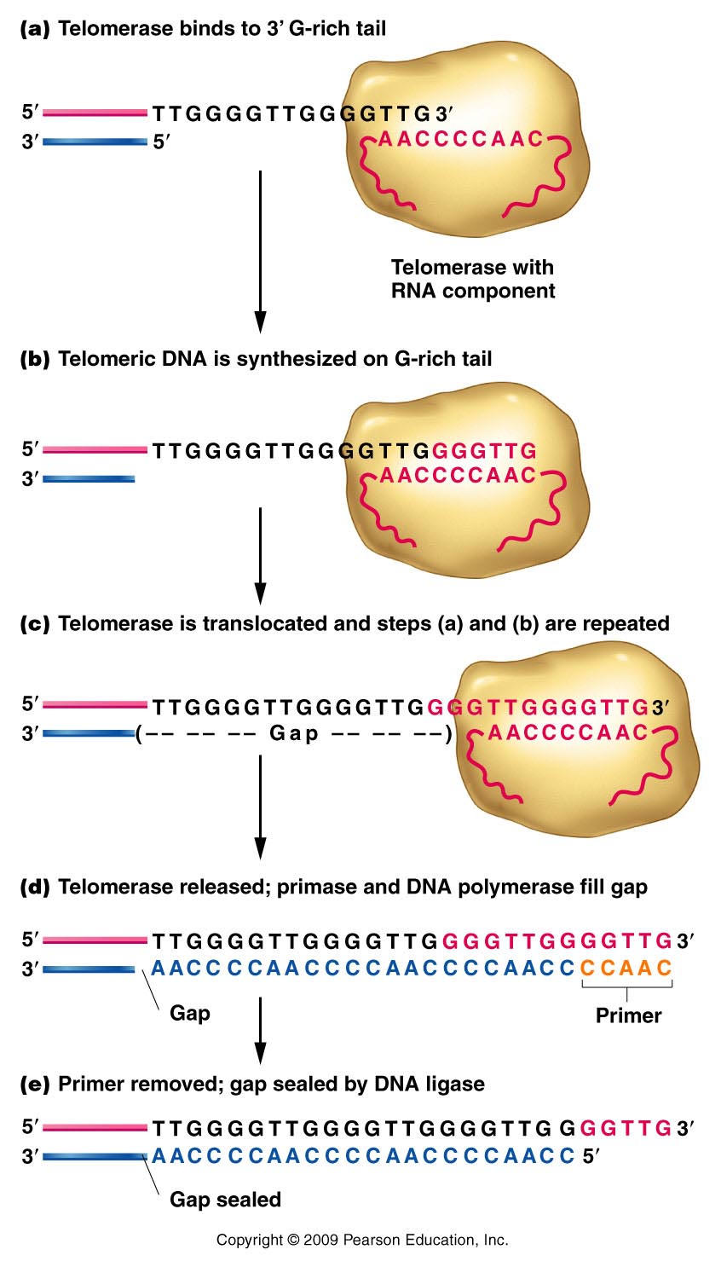
TELOMERASE DIRECTS
SYNTHESIS OF THE
TELOMERE REPEAT
SEQUENCE TO FILL GAP
THIS ENZYME IS A
RIBONUCLEOPROTEIN
WITH AN RNA MOLECULE
THAT SERVES AS THE
TEMPLATE FOR THE
SYNTHESIS OF ITS
DNA COMPLEMENT

Slide 23
BINDING
POLYMERIZATION
Reverse transcriptase
Translocation
RNA primer

Slide 24
SIMILAR ENZYMES FUNCTION FOR
TELOMERIC SEQUENCES IN ALMOST ALL
EUKARYOTES
TELOMERIC SEQUENCES HAVE BEEN HIGHLY
CONSERVED THROUGHOUT EVOLUTION
TELOMERE SHORTENING HAS BEEN LINKED
TO THE MOLECULAR MECHANISMS INVOLVED
IN CELLULAR AGING
IN FACT IN MOST OF THE EUKARYOTIC
SOMATIC CELLS TELOMERASE IS NOT ACTIVE

Slide 25
