Slide 1
DNA STRUCTURE AND ANALYSIS

Slide 2
THE GENETIC MATERIAL MUST EXHIBIT
FOUR CHARACTERISTICS,
IT MUST BE ABLE TO:
REPLICATE
STORE INFORMATION
EXPRESS INFORMATION
ALLOW VARIATION BY MUTATION

Slide 3
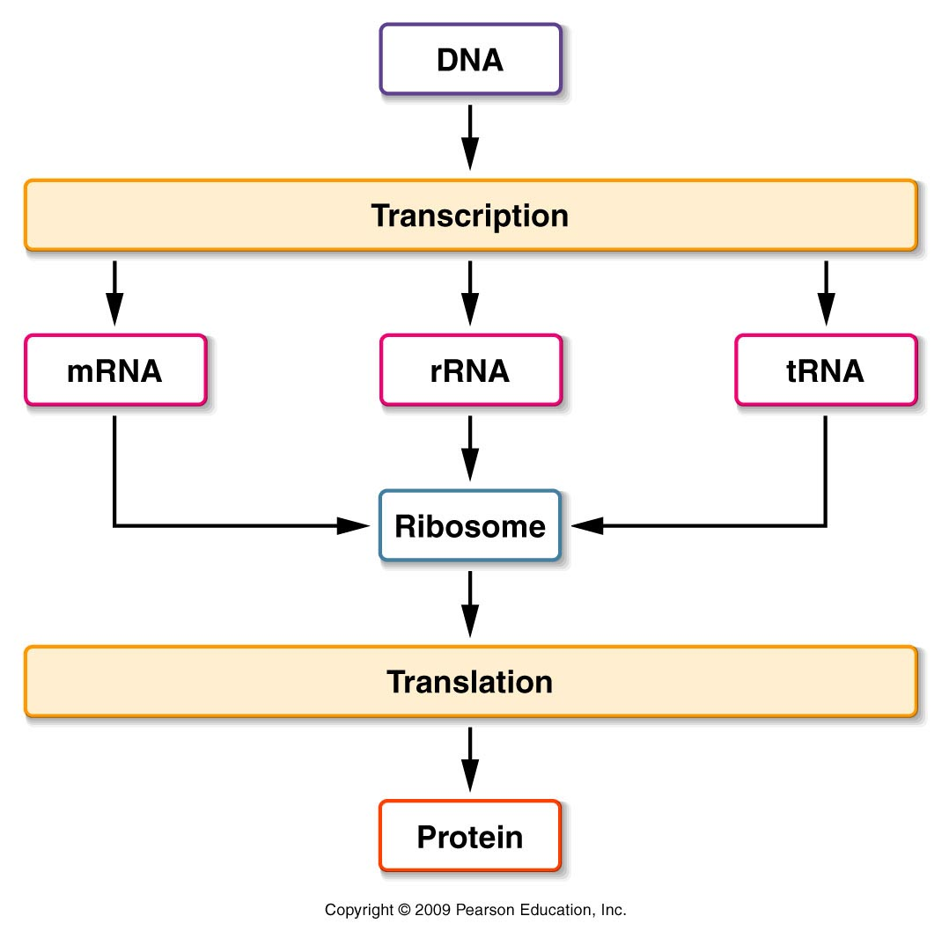
THE CENTRAL DOGMA OF MOLECULAR GENETICS IS THAT DNA MAKES RNA,
WHICH MAKES PROTEINS

Slide 4
THE GENETIC MATERIAL?
THE GENETIC MATERIAL IS PHYSICALLY TRANSMITTED FROM PARENT TO OFFSPRING
PROTEINS AND NUCLEIC ACIDS WERE THE MAJOR CANDIDATES FOR THE GENETIC MATERIAL
FOR A LONG TIME, PROTEIN WAS FAVORED
TO BE THE GENETIC MATERIAL
IT IS ABUNDANT IN CELLS
IT WAS THE SUBJECT OF THE MOST ACTIVE AREAS OF GENETIC RESEARCH

Slide 5
DNA WAS FIRST STUDIED IN 1868 BY F. MIESCHER
AND CALLED AS NUCLEIN
DNA WAS THOUGHT TO BE TOO SIMPLE TO BE
THE GENETIC MATERIAL, WITH ONLY FOUR TYPES
OF NUCLEOTIDES AS COMPARED TO THE 20
DIFFERENT AMINO ACIDS OF PROTEINS

Slide 6
THE GENETIC MATERIAL?
EVIDENCE FAVORING DNA AS THE GENETIC
MATERIAL WAS FIRST OBTAINED DURING THE
STUDY OF BACTERIA AND BACTERIOPHAGES
IN 1927 GRIFFITH SHOWED THAT AVIRULENT
STRAINS OF Diplococcus pneumoniae COULD BE
TRANSFORMED TO VIRULENCE
HE SPECULATED THAT THE TRANSFORMING
PRINCIPLE COULD BE PART OF THE
POLYSACCHARIDE CAPSULE OR SOME
COMPOUND REQUIRED FOR CAPSULE
SYNTHESIS

Slide 7
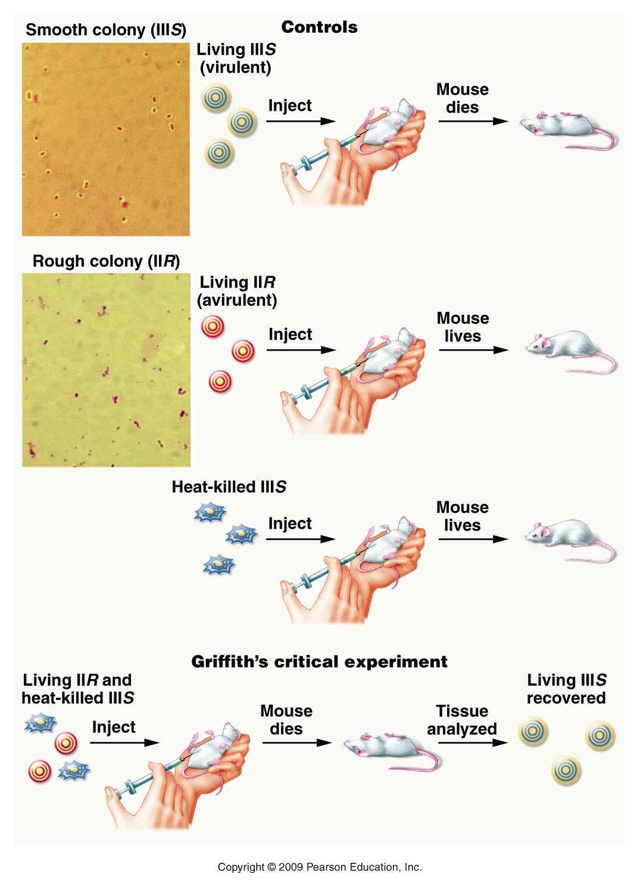

Slide 8
THE GENETIC MATERIAL?
THE 1944 PUBLICATION BY OSWALD AVERY,
COLIN MACLEOD, AND MACLYN MCCARTY
CONCERNING THE CHEMICAL NATURE OF A
“TRANSFORMING PRINCIPLE” IN BACTERIA
WAS THE INITIAL EVENT LEADING TO THE
ACCEPTANCE OF DNA AS THE GENETIC
MATERIAL
AVERY, MACLEOD, AND MCCARTY
DEMONSTRATED THAT THE TRANSFORMING
PRINCIPLE WAS DNA AND NOT PROTEIN

Slide 9
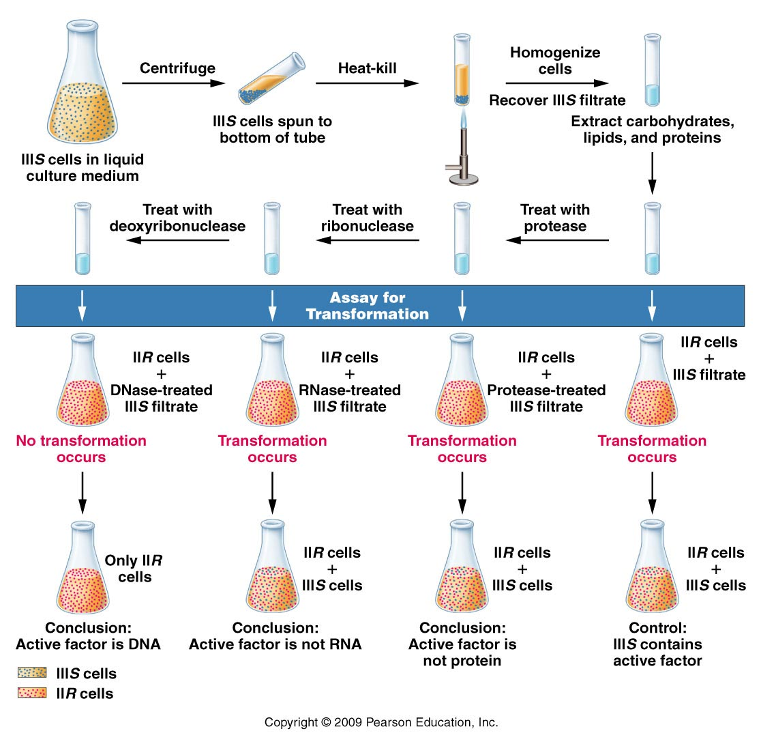

Slide 10
THE GENETIC MATERIAL?
HERSHEY AND CHASE DEMONSTRATED THAT DNA,
AND NOT PROTEIN, ENTERS THE BACTERIAL CELL
DURING BACTERIOPHAGE INFECTION AND
DIRECTS VIRAL REPRODUCTION
FOLLOWING INFECTION, THE VIRAL COMPONENT
“COMMANDEERS” THE CELLULAR MACHINERY OF
THE HOST AND CAUSES VIRAL REPRODUCTION
IN A REASONABLY SHORT TIME, MANY NEW
PHAGES ARE CONSTRUCTED AND THE BACTERIAL
CELL IS LYSED, RELEASING THE PROGENY VIRUSES
THIS PROCESS IS REFERRED TO AS THE LYTIC CYCLE

Slide 11
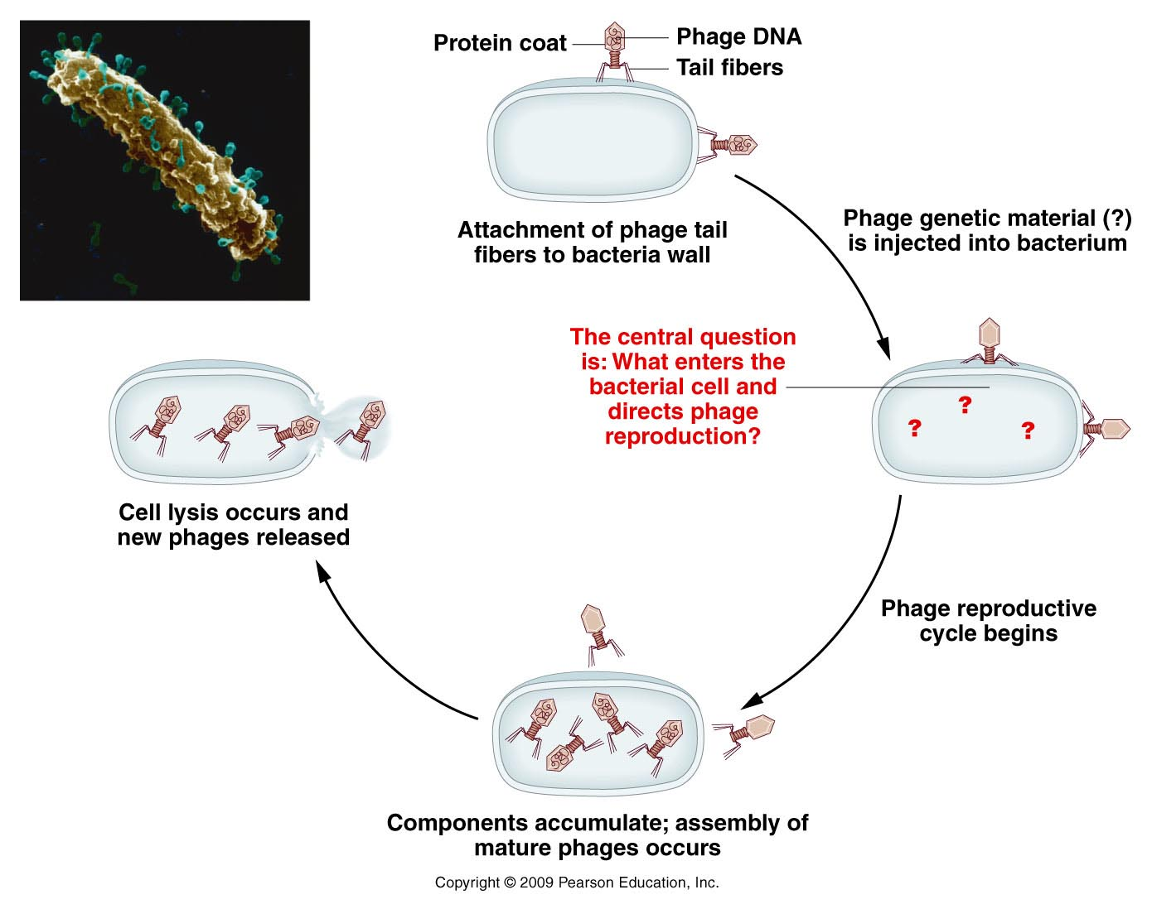
Reproductive cycle of a T-even bacteriophage, as known in 1952

Slide 12
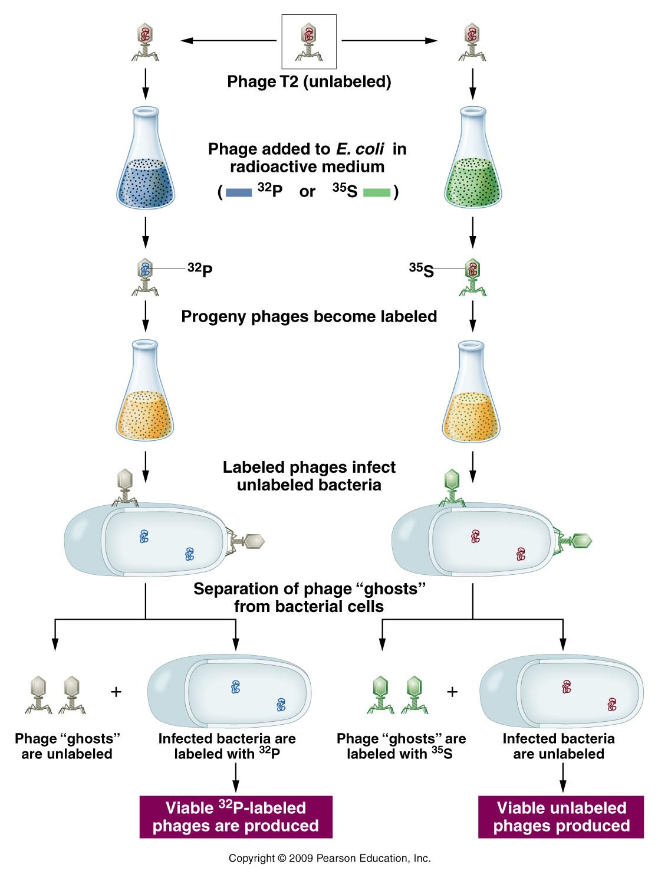

Slide 13
TRANSFECTION OF VIRAL DNA INTO
BACTERIAL CELLS PROVED CONCLUSIVELY THAT
THE VIRAL DNA ALONE CONTAINS ALL THE
NECESSARY INFORMATION FOR PRODUCTION OF
MATURE VIRUSES
THESE EXPERIMENTS ALONG WITH THOSE OF
AVERY AND HIS COLLEAGUES, PROVIDED
CONVINCING EVIDENCE THAT DNA WAS THE
MOLECULE RESPONSIBLE FOR HEREDITY
THIS CONCLUSION HAS SINCE SERVED AS THE
CORNERSTONE OF THE FIELD OF MOLECULAR
GENETICS

Slide 14
INDIRECT AND DIRECT EVIDENCES
SUPPORT THE CONCEPT THAT DNA IS
THE GENETIC MATERIAL IN
EUKARYOTES
DNA IS FOUND ONLY WHERE THE PRIMARY GENETIC FUNCTION OCCURS. WHEREAS PROTEIN IS FOUND THROUGHOUT THE CELL.
THIS PROVIDES INDIRECT EVIDENCE FOR DNA AS THE GENETIC MATERIAL.

Slide 15
UV LIGHT IS CAPABLE OF INDUCING MUTATIONS
IN THE GENETIC MATERIAL AND IS MOST
MUTAGENIC AT A WAVELENGTH OF 260nm.
DNA AND RNA ABSORB UV LIGHT MOST
STRONGLY AT 260nm, BUT PROTEIN ABSORBS
MOST STRONGLY AT 280nm, A WAVELENGTH AT
WHICH NO SIGNIFICANT MUTAGENIC EFFECTS
ARE OBSERVED.
AGAIN, THIS PROVIDES INDIRECT EVIDENCE
FOR DNA AS THE GENETIC MATERIAL.

Slide 16
THE STRONGEST DIRECT EVIDENCE FOR DNA
AS THE GENETIC MATERIAL COMES FROM
RECOMBINANT DNA TECHNOLOGY.
SEGMENTS OF EUKARYOTIC DNA CORRESPONDING
TO SPECIFIC GENES ARE ISOLATED AND SPLICED
INTO THE BACTERIAL DNA.
THE PRESENCE OF THE EUKARYOTIC GENE
PRODUCT IN BACTERIA CONTAINING THE
EUKARYOTIC GENE PROVIDES DIRECT EVIDENCE
THAT DNA IS PRESENT AND FUNCTIONAL IN
THE BACTERIAL CELL

Slide 17
RNA SERVES AS THE GENETIC MATERIAL
IN SOME VIRUSES
SOME VIRUSES HAVE A RNA CORE
RATHER THAN A DNA CORE
THIS RNA SERVES AS THE GENETIC
MATERIAL FOR THESE VIRUSES

Slide 18
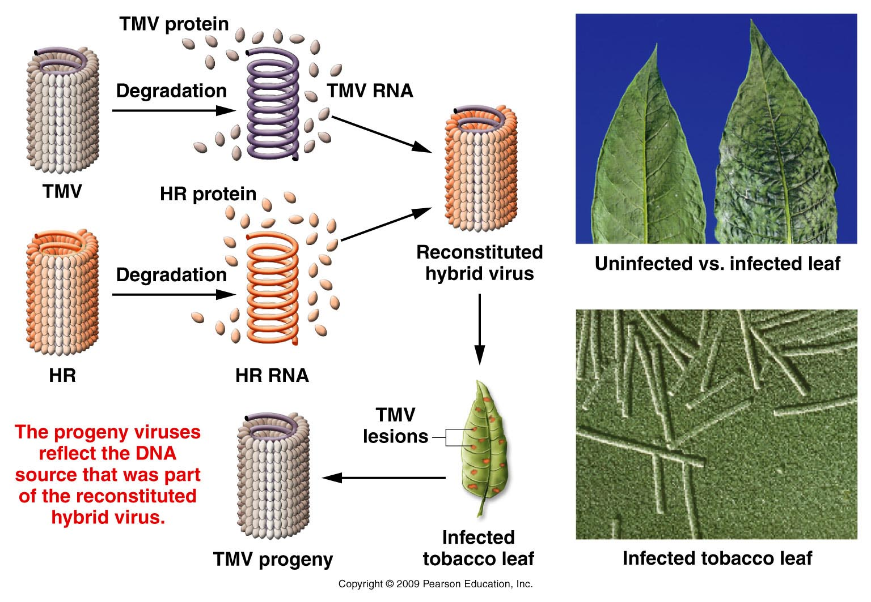
Reconstitution of hybrid tobacco mosaic viruses. In the hybrid, RNA is derived from the wild-type TMV virus, while the protein subunits are derived from the HR (Holmes ribgrass) strain. Following infection, viruses are produced with protein subunits characteristic of the wild-type TMV strain and not those of the HR strain.

Slide 19
REPLICATION OF THE VIRAL RNA IS
DEPENDENT ON RNA REPLICASE
RETROVIRUSES REPLICATE IN AN
UNUSUAL WAY
THE RNA SERVES AS A TEMPLATE FOR
SYNTHESIS OF A COMPLEMENTARY DNA BY
THE RNA-DEPENDENT DNA POLYMERASE
REVERSE TRANSCRIPTASE
THIS DNA CAN BE INCORPORATED INTO THE
HOST CELL GENOME

Slide 20
KNOWLEDGE OF NUCLEIC ACID
CHEMISTRY IS ESSENTIAL TO THE
UNDERSTANDING OF DNA STRUCTURE
NUCLEOTIDES ARE THE BUILDING BLOCKS
OF DNA
THEY CONSIST OF:
a nitrogenous base
a pentose sugar
a phosphate group

Slide 21
THE NITROGENOUS BASES CAN BE
PURINES OR PYRIMIDINES
THE PURINES ARE ADENINE (A) AND
GUANINE (G)
THE PYRIMIDINES ARE CYTOSINE (C),
THYMINE (T), AND URACIL (U)

Slide 22
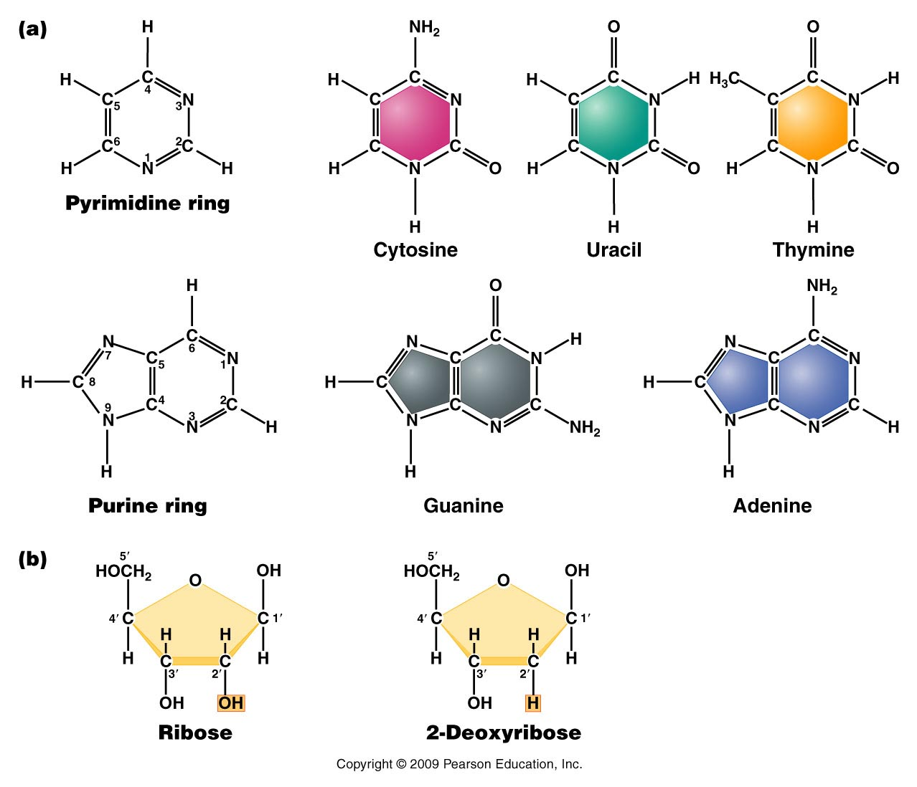

Slide 23
DNA AND RNA BOTH CONTAIN A, C, AND G.
ONLY DNA CONTAINS T.
ONLY RNA CONTAINS U.
RNA CONTAINS RIBOSE AS ITS SUGAR.
DNA CONTAINS DEOXYRIBOSE

Slide 24
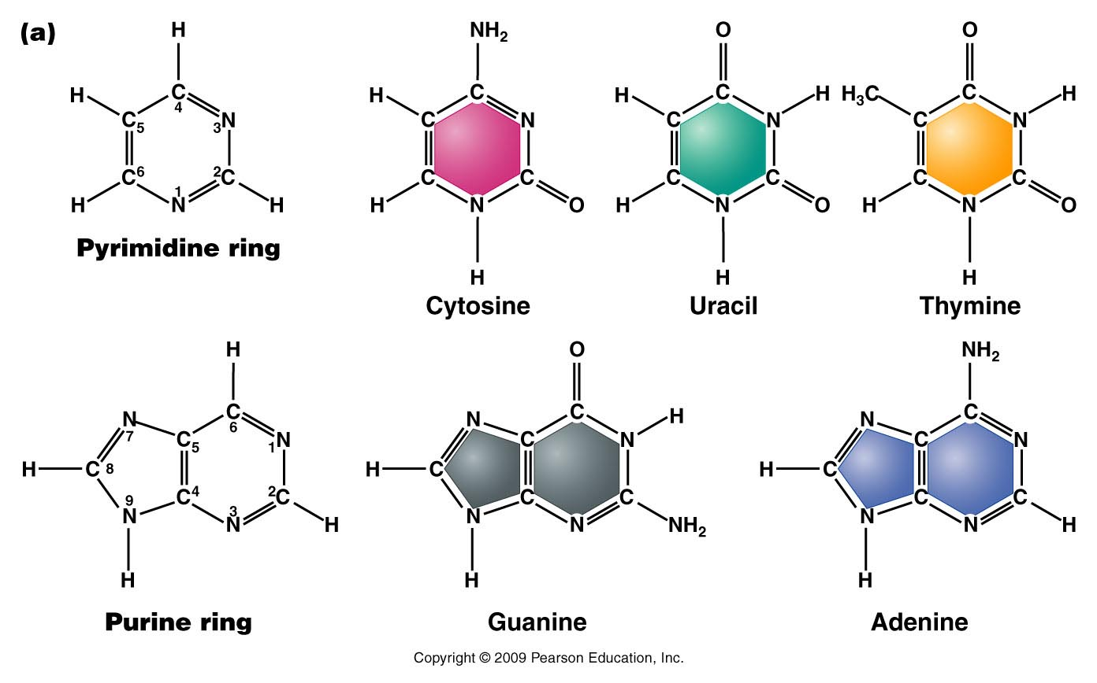

Slide 25
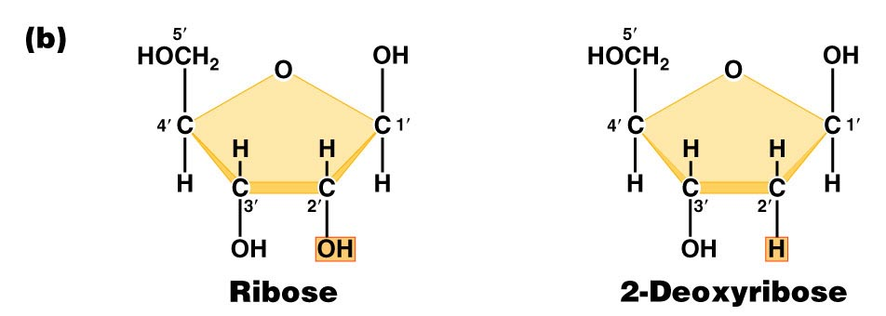

Slide 26
A NUCLEOSIDE CONTAINS THE NITROGENOUS
BASE AND THE PENTOSE SUGAR
A NUCLEOTIDE IS A NUCLEOSIDE WITH
A PHOSPHATE GROUP ADDED

Slide 27
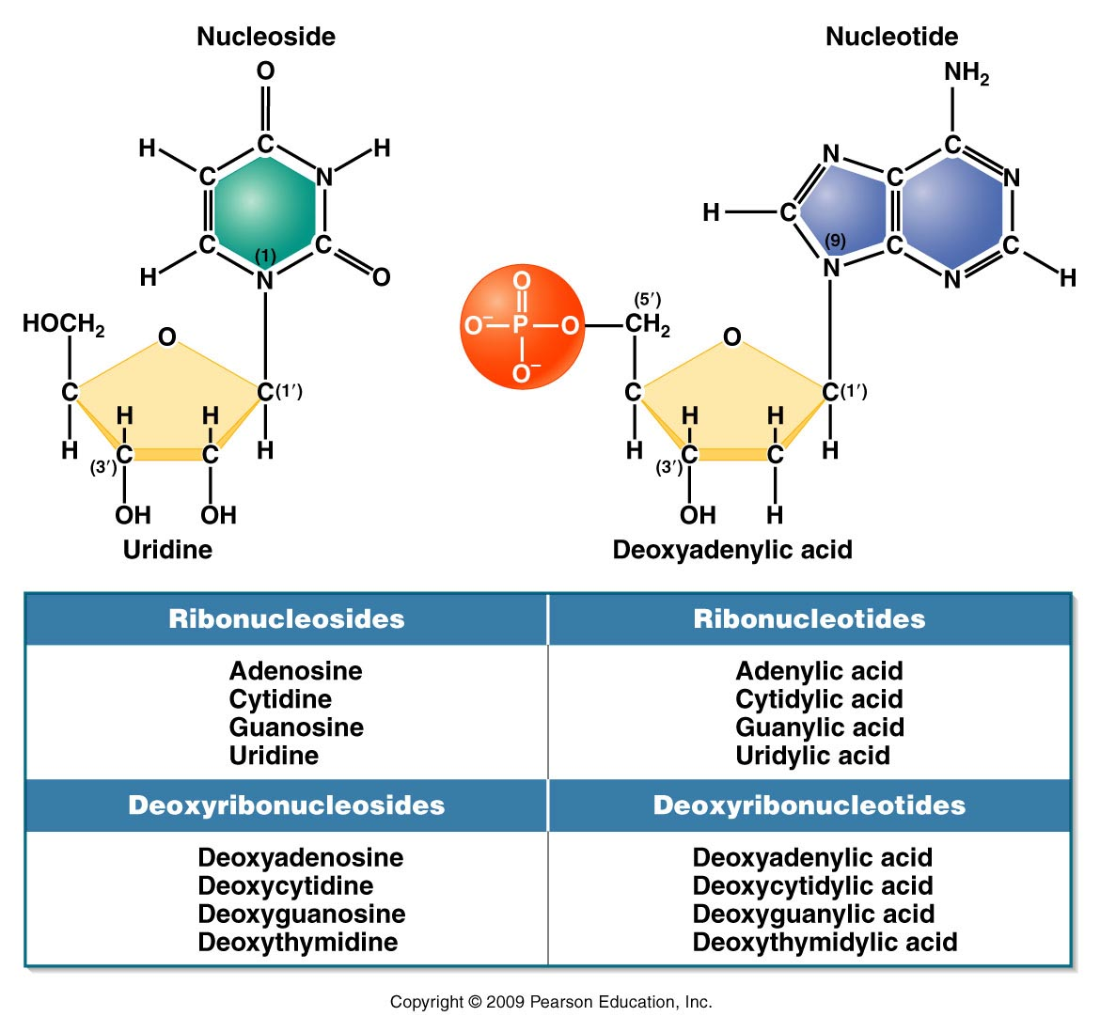

Slide 28
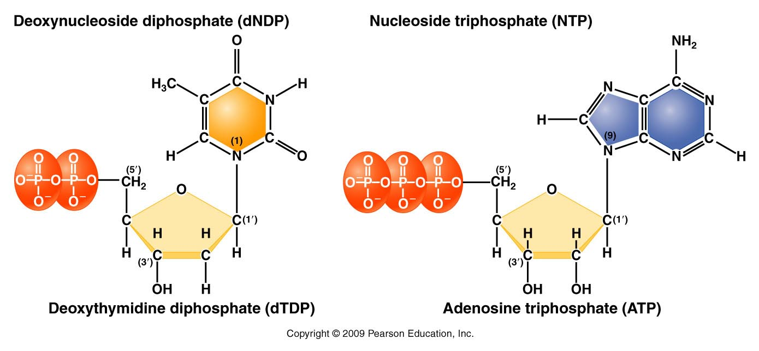
The C-5' position is the location of the phosphate group on a nucleotide
Nucleotides can have one, two, or three phosphate groups and are called NMPs, NDPs, and NTPs, respectively

Slide 29
NUCLEOTIDES ARE LINKED BY A
PHOSPHODIESTER BOND BETWEEN
THE PHOSPHATE GROUP AT THE C-5’
POSITION AND THE -OH GROUP ON THE
C-3' POSITION

Slide 30
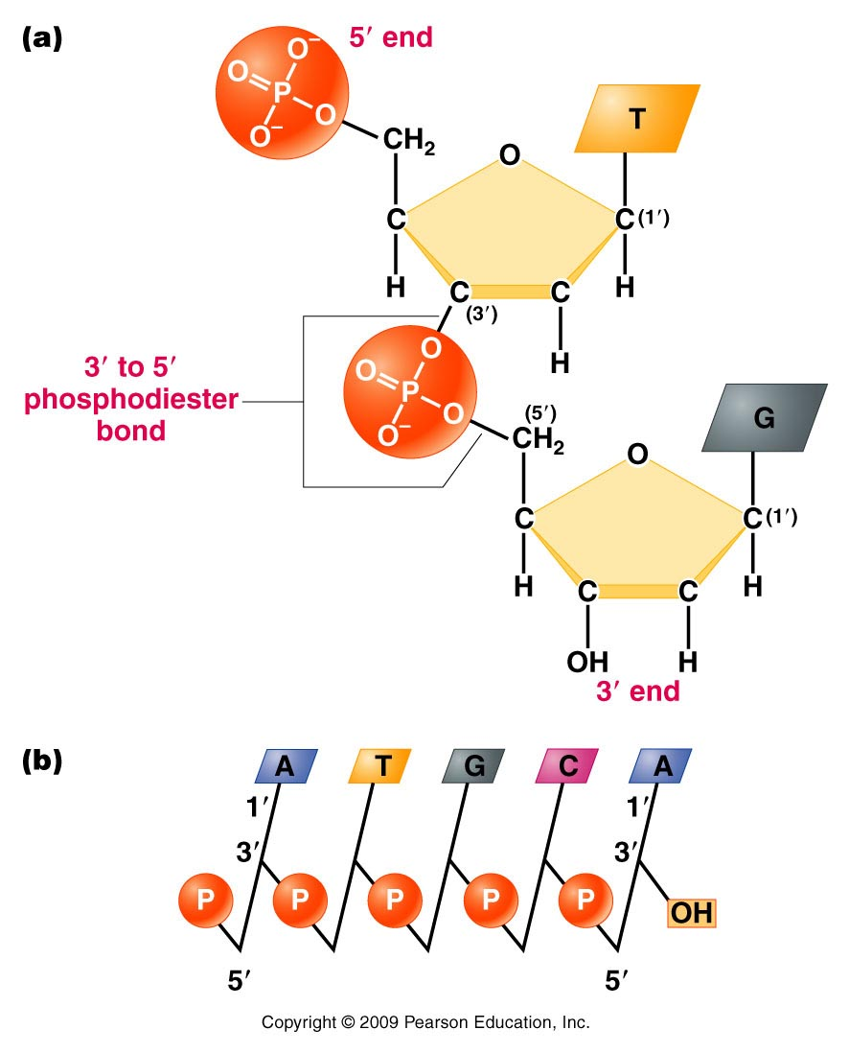

Slide 31
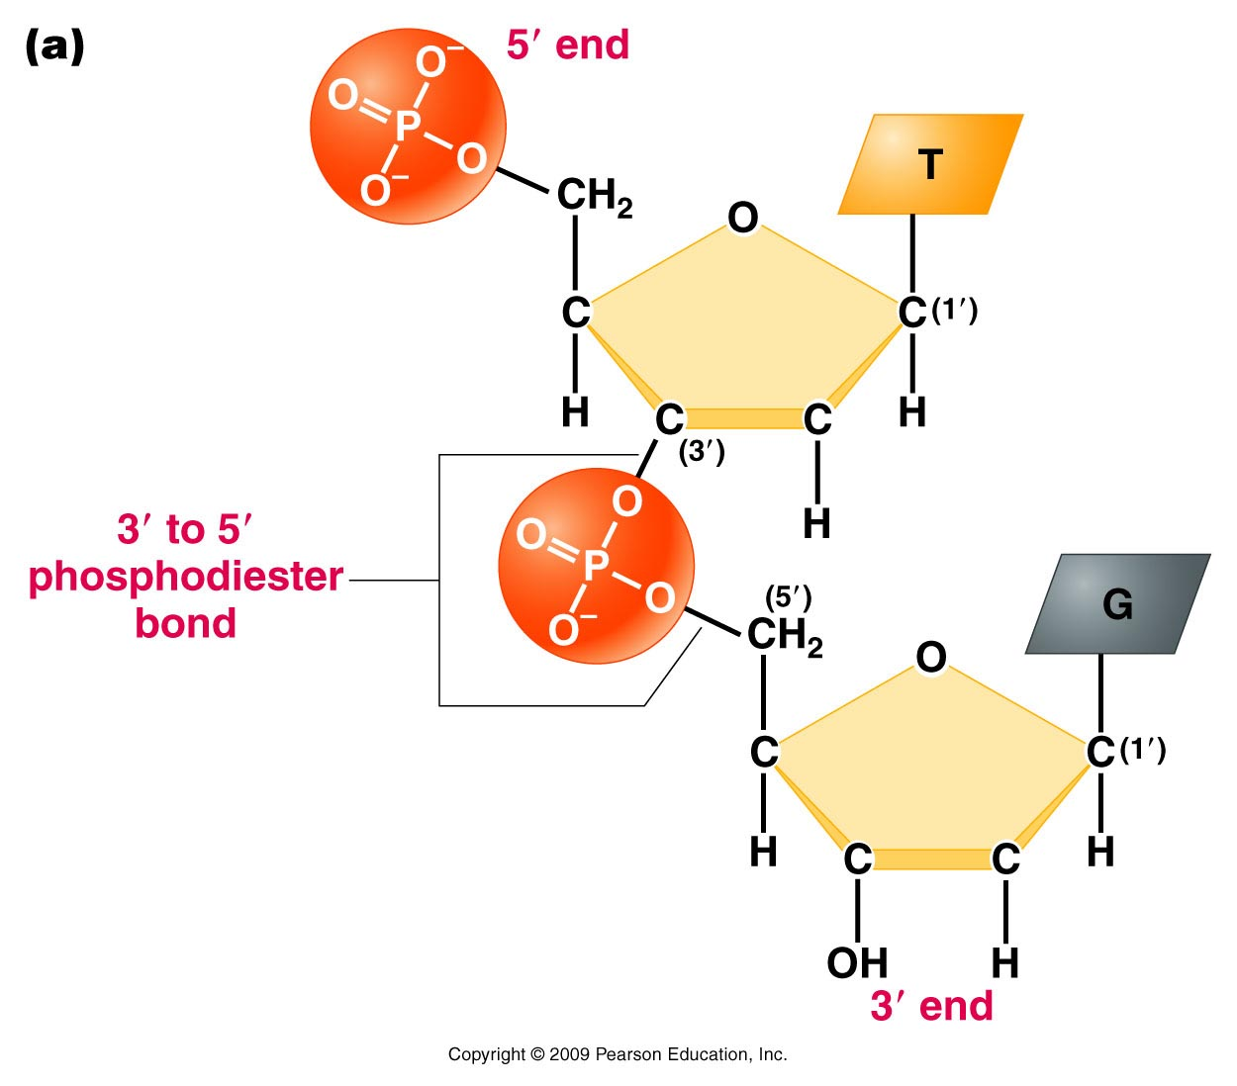
LINKAGE OF TWO NUCLEOTIDES BY THE FORMATION OF
A PHOSPHODIESTER BOND, PRODUCING A DINUCLEOTIDE

Slide 32
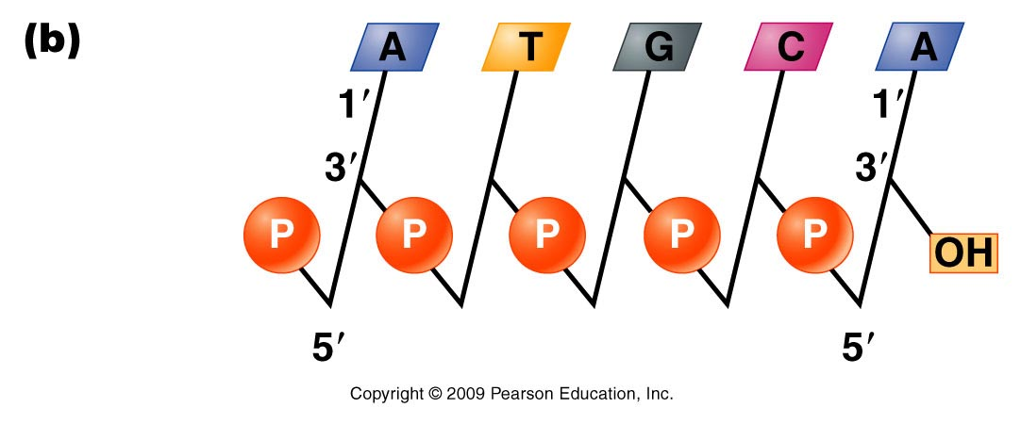
SHORT AND NOTATION FOR A POLYNUCLEOTIDE CHAIN
Notes:
Figure 10.12b (a) (b).

Slide 33
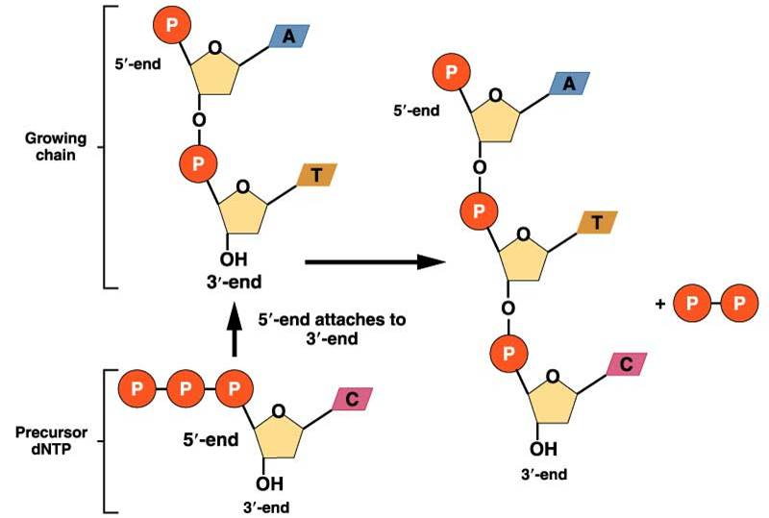
Nucleotide Polymerization Reaction: Phosphodiester Bond Formation

Slide 34
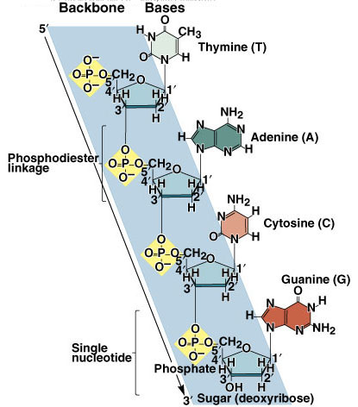
Copyright ©The McGraw-Hill Companies, Inc. Permission required for reproduction or display

Slide 35
THE STRUCTURE OF DNA HOLDS THE KEY TO
UNDERSTANDING ITS FUNCTION
CHARGAFF SHOWED THAT THE AMOUNT OF “A”
IS PROPORTIONAL TO “T” AND THE AMOUNT OF “C”
IS PROPORTIONAL TO “G”, BUT THE PERCENTAGE
OF “C + G” DOES NOT NECESSARILY EQUAL THE
PERCENTAGE OF “A + T”

Slide 36
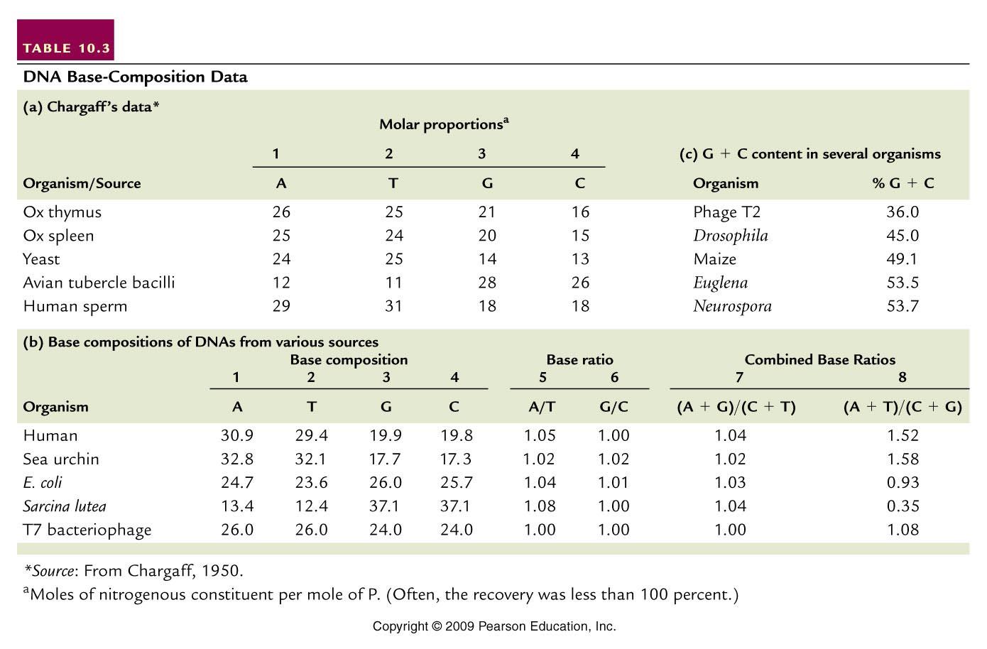

Slide 37
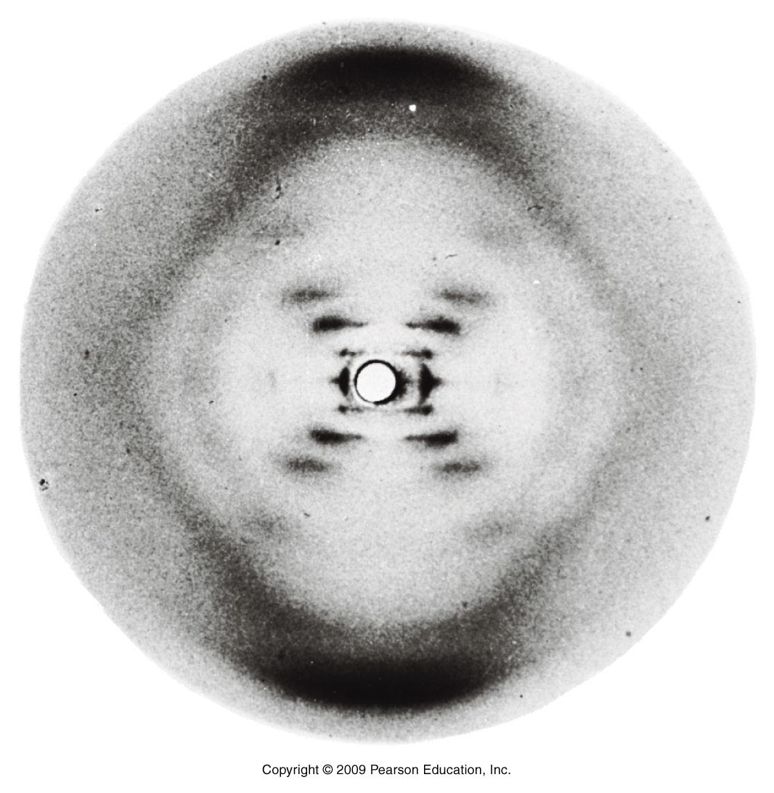
X-ray diffraction of DNA showed a 3.4 angstrom periodicity, characteristic of a
helical structure

Slide 38
THE WATSON-CRICK MODEL
WATSON AND CRICK PROPOSED DNA IS
A RIGHT-HANDED DOUBLE HELIX IN
WHICH THE TWO STRANDS ARE
ANTIPARALLEL AND THE BASES ARE
STACKED ON ONE ANOTHER
THE TWO STRANDS ARE CONNECTED
BY A-T AND G-C BASE PAIRING AND
THERE ARE 10 BASE PAIRS PER HELIX
TURN

Slide 39
THE A-T AND G-C BASE PAIRING PROVIDES
COMPLEMENTARITY OF THE TWO STRANDS
AND CHEMICAL STABILITY TO THE HELIX
A-T BASE PAIRS FORM TWO HYDROGEN
BONDS AND G-C BASE PAIRS FORM THREE
HYDROGEN BONDS
THE ARRANGEMENT OF SUGARS AND BASES
ALONG THE AXIS PROVIDES ANOTHER
STABILIZING FACTOR

Slide 40
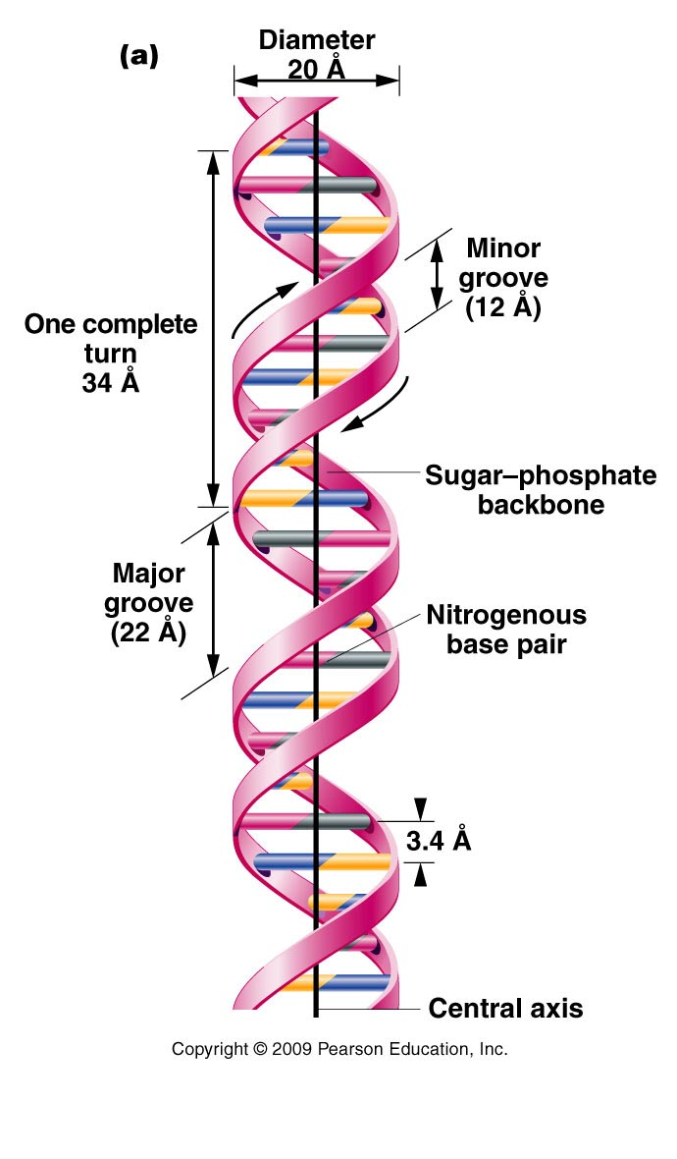
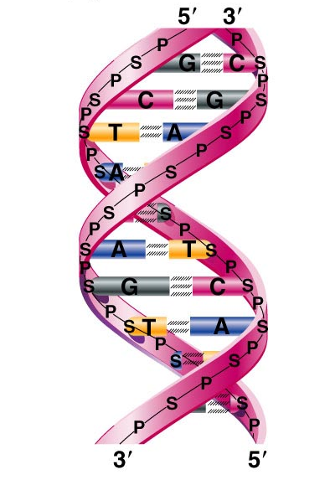

Slide 41
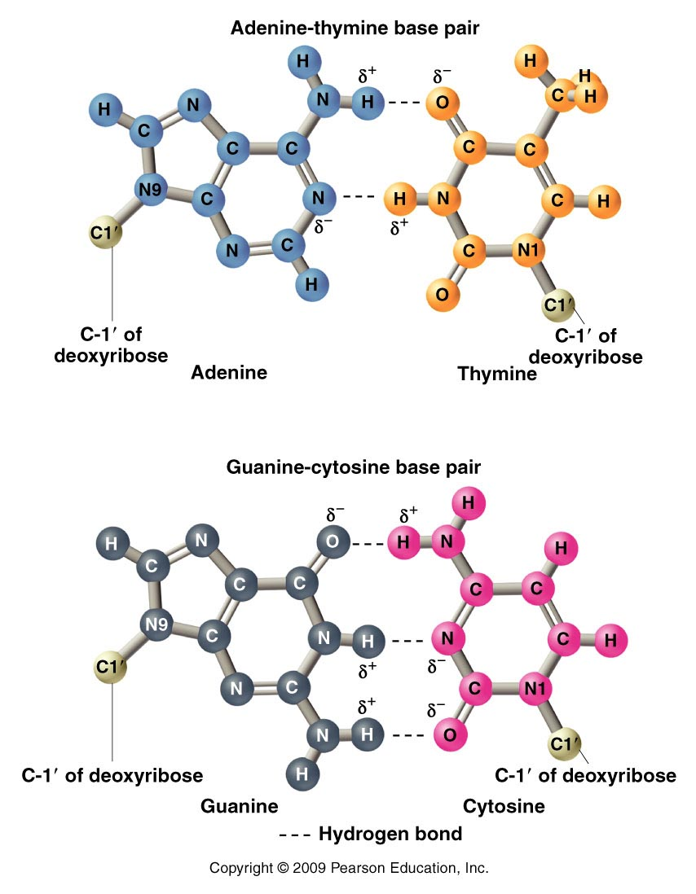

Slide 42
ALTERNATIVE FORMS OF DNA EXIST
THE WATSON-CRICK DNA MODEL IS OF B-DNA,
WHICH IS BELIEVED TO BE THE BIOLOGICALLY
SIGNIFICANT FORM
A-DNA IS SLIGHTLY MORE COMPACT THAN B-DNA
C-DNA, D-DNA, AND E-DNA ARE ALSO RIGHT-HANDED FORMS OF DNA THAT ARE LESS COMPACT THAN B-DNA
Z-DNA FORMS A LEFT-HANDED DOUBLE HELIX

Slide 43
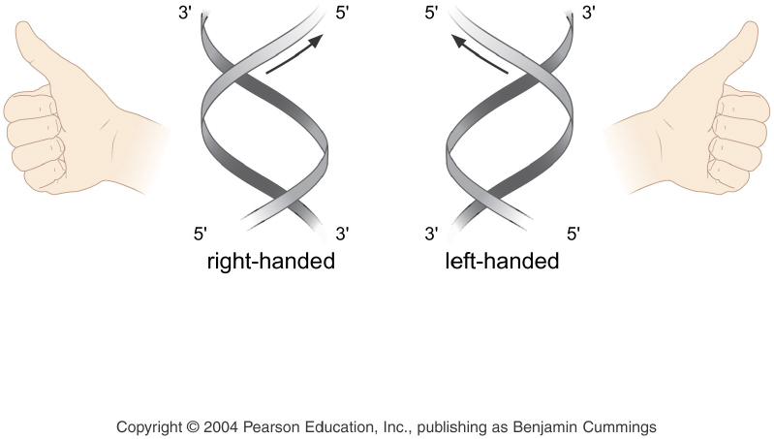
Helices Can be Right or Left Handed

Slide 44
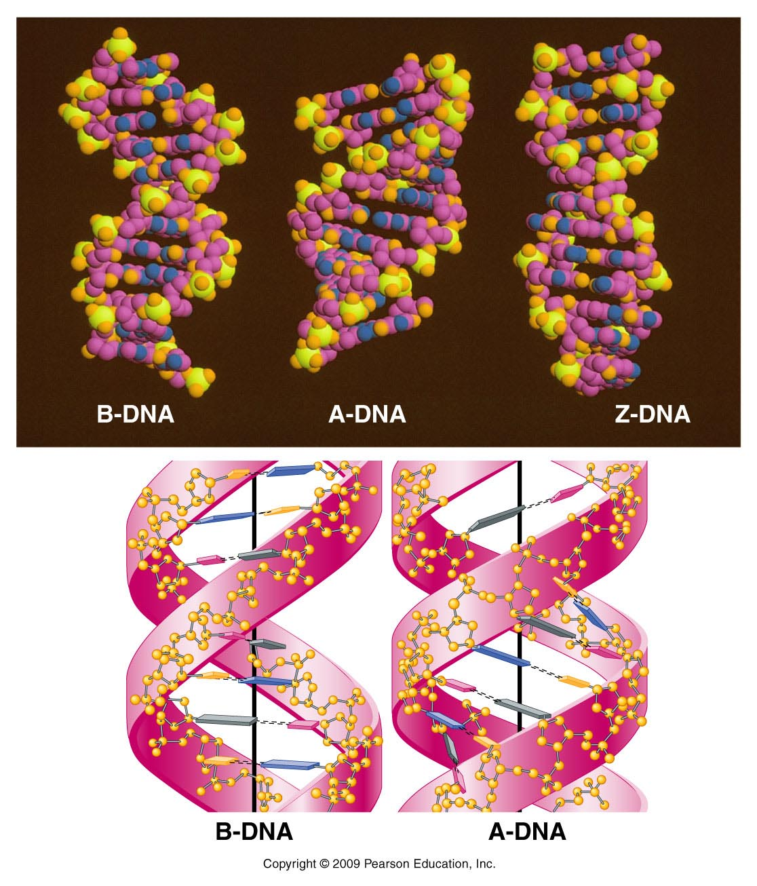

Slide 45
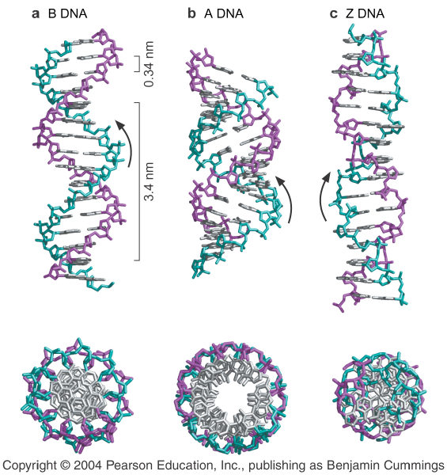
Different Forms of DNA

Slide 46
RNA
THE STRUCTURE OF RNA IS
CHEMICALLY SIMILAR TO DNA, BUT IT IS
SINGLE STRANDED
IN RNA:
THE SUGAR RIBOSE REPLACES DEOXYRIBOSE OF DNA
AND URACIL REPLACES THYMINE OF DNA

Slide 47
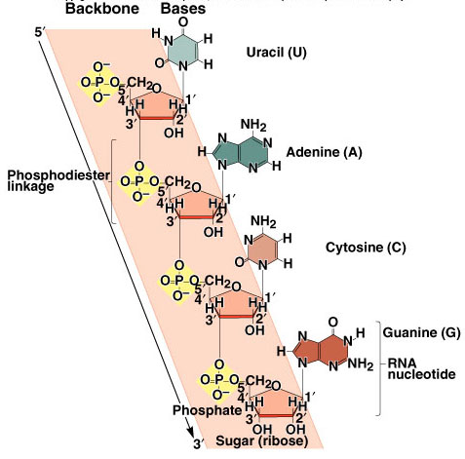

Slide 48
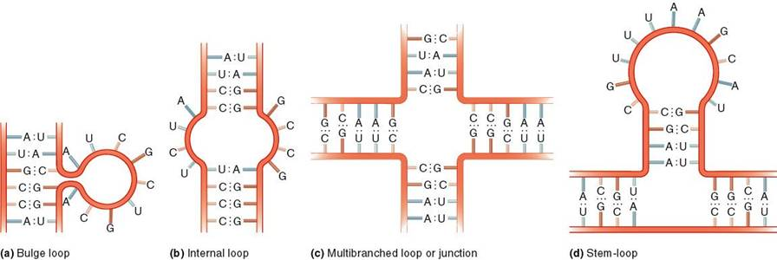
RNA Secondary Structures

Slide 49
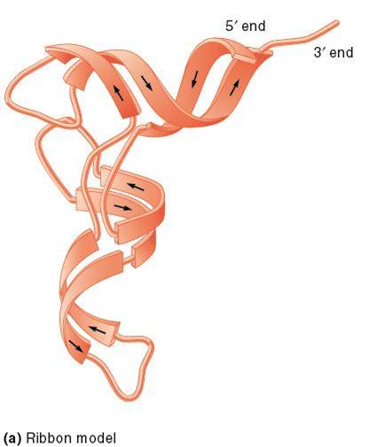
RNA Tertiary Structure – a tRNA

Slide 50
MOST RNA IS SINGLE STRANDED,
ALTHOUGH SOME RNAS FORM DOUBLE
STRANDED REGIONS AS THEY FOLD
INTO DIFFERENT SECONDARY
STRUCTURES
IN ADDITION, SOME VIRUSES HAVE A
DOUBLE-STRANDED RNA GENOME

Slide 51
THERE ARE THREE CLASSES OF
CELLULAR RNAS:
MESSENGER RNA (mRNA)
RIBOSOMAL RNA (rRNA)
TRANSFER RNA (tRNA)

Slide 52
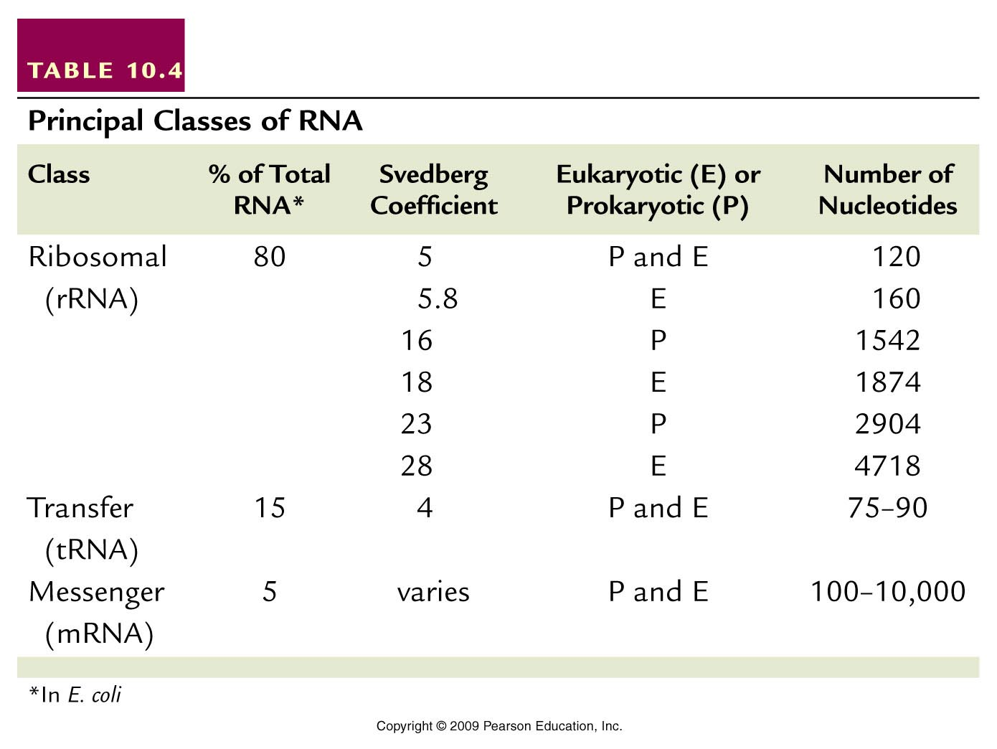
Table 10.4
Notes:
Table 10.4 RNA Characterization

Slide 53
ALL RNAS ORIGINATE AS COMPLEMENTARY
COPIES OF ONE OF THE TWO STRANDS OF
DNA
DNA SERVES AS THE TEMPLATE FOR THEIR
SYNTHESIS
rRNAS ARE COMPONENTS OF RIBOSOMES FOR PROTEIN SYNTHESIS
mRNAS ARE THE TEMPLATE FOR PROTEIN SYNTHESIS
tRNAS CARRY AMINO ACIDS FOR PROTEIN SYNTHESIS

Slide 54
MANY ANALYTICAL TECHNIQUES HAVE BEEN USEFUL
DURING THE INVESTIGATION OF DNA AND RNA
Nucleic acids absorb UV light most strongly at 260 nm
due to interaction between UV light and the ring systems
of the bases
Nucleic acids can be separated by gradient
centrifugation procedures
Sedimentation equilibrium centrifugation separates
by density gradient
Sedimentation velocity centrifugation measures
the velocity of sedimentation in Svedberg coefficient
units

Slide 55
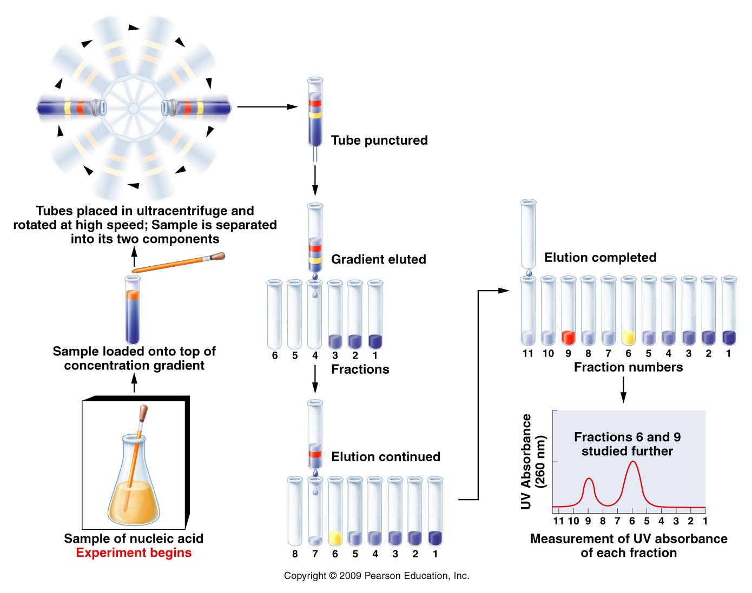

Slide 56
MANY ANALYTICAL TECHNIQUES HAVE BEEN USEFUL
DURING THE INVESTIGATION OF DNA AND RNA
Hyperchromic shift during DNA denaturation is used to
determine the melting temperature(T_{m})
Melting temperature is a method for estimating the base
composition of DNA
Increase in UV absorption vs. temperature (the
hyperchromic effect) for two DNA molecules with different
GC contents

Slide 57
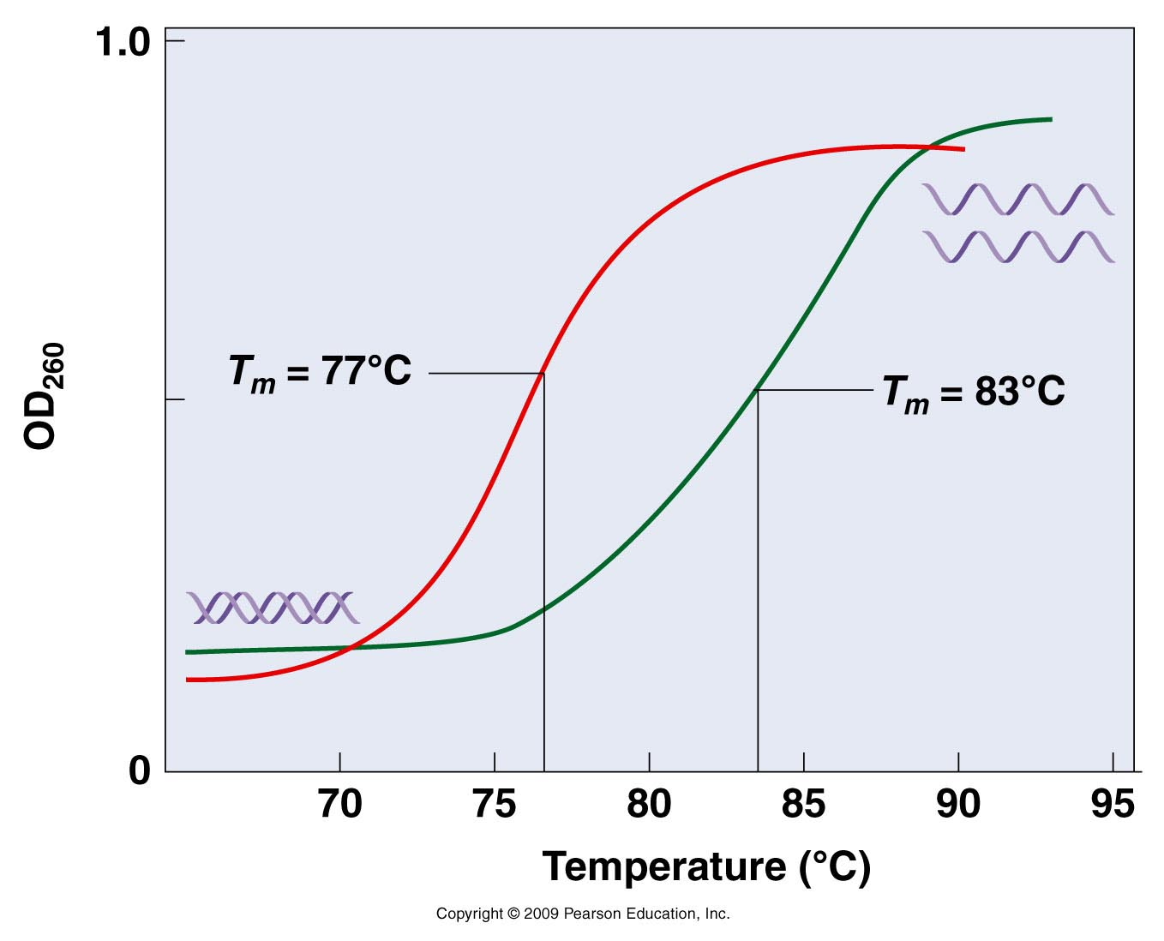
The molecule with a melting point of 83° C has a greater GC content than the molecule with a of 77° C.
Notes:
Figure 10.20

Slide 58
MANY ANALYTICAL TECHNIQUES HAVE BEEN USEFUL
DURING THE INVESTIGATION OF DNA AND RNA
In molecular hybridization, DNA strands (or DNA and
RNA strands) can be renatured to each other
This has provided the basis for several techniques for
analyzing DNA

Slide 59
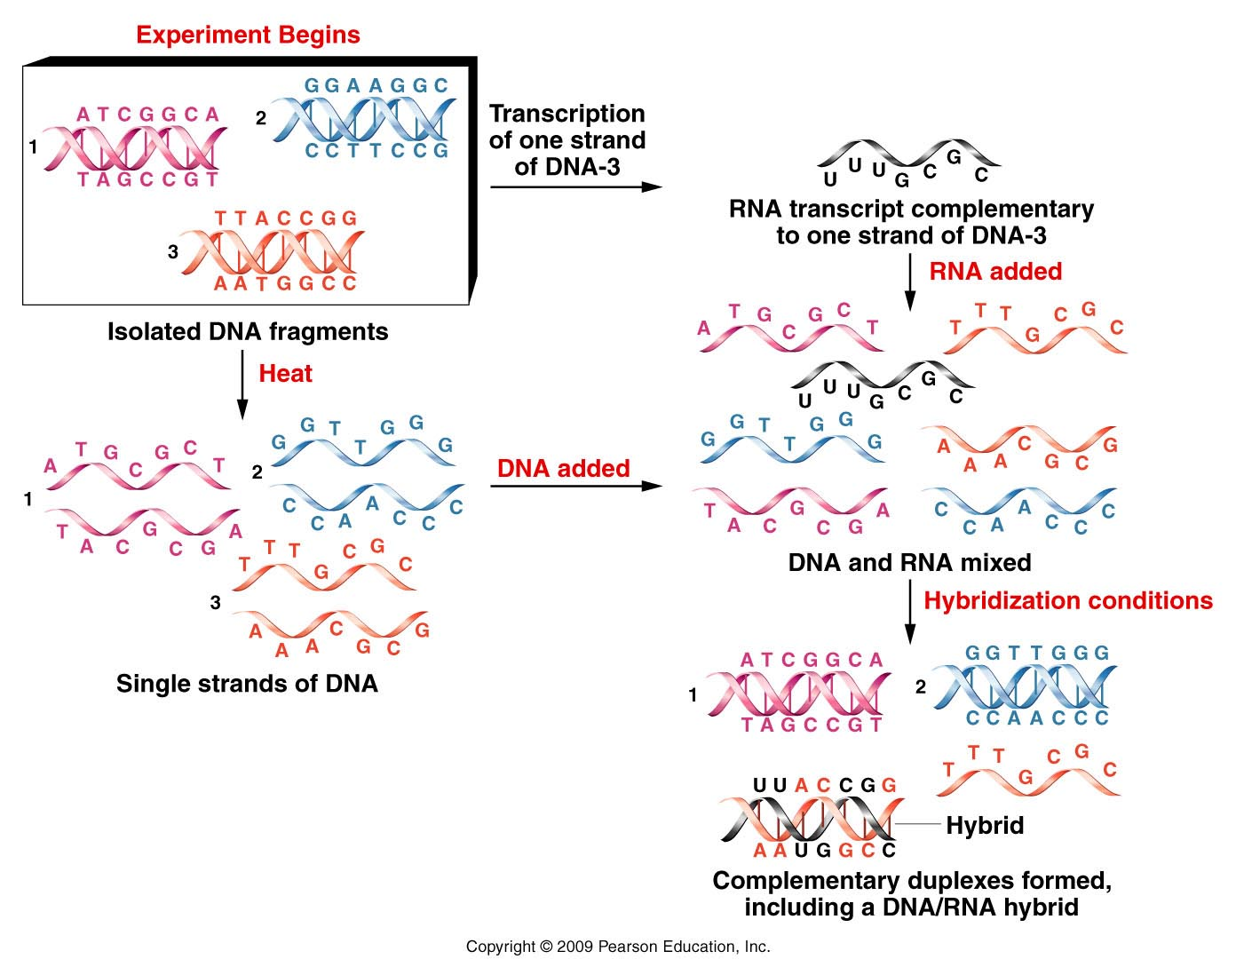

Slide 60
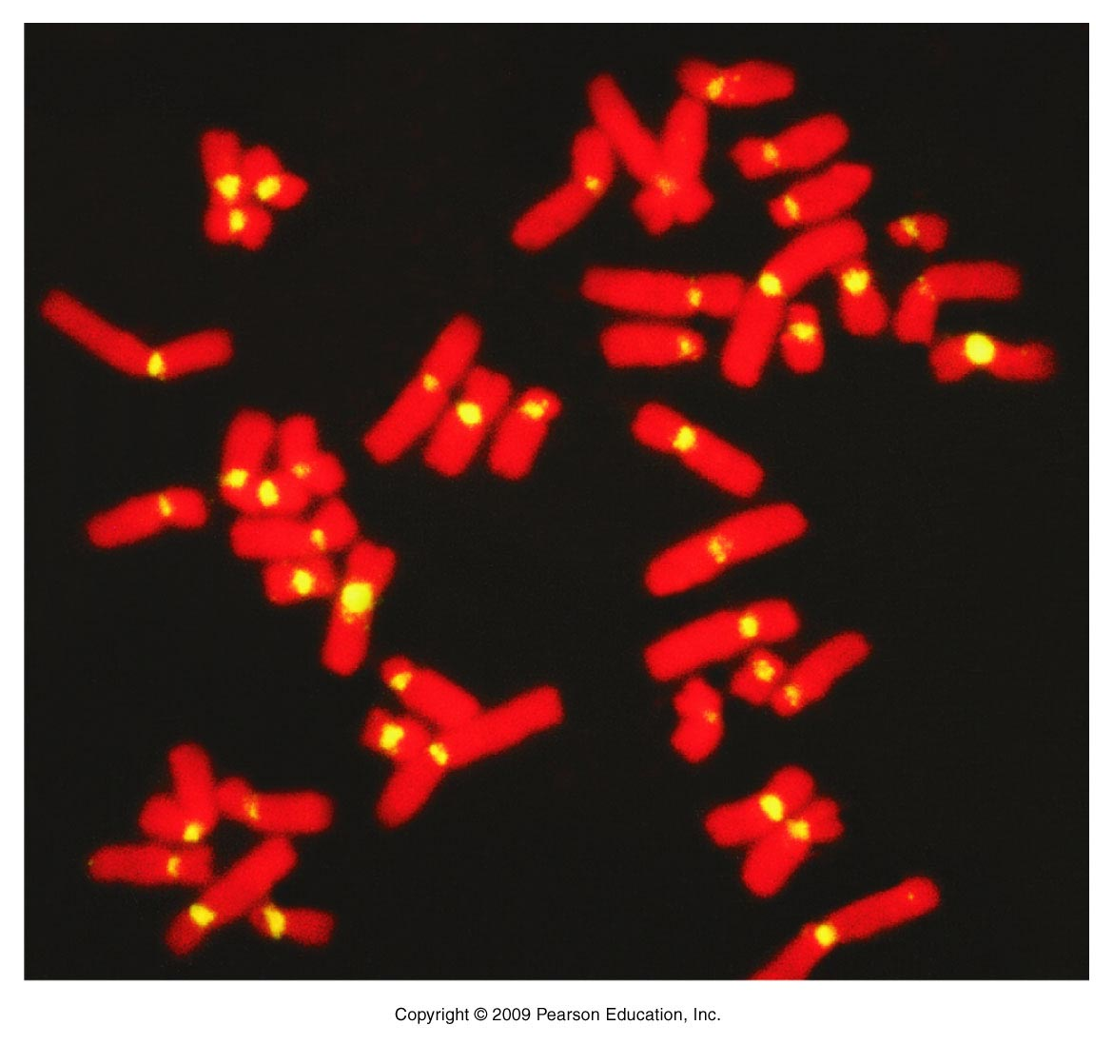
Fluorescent in situ hybridization (FISH) is used to identifying the chromosomal location of a DNA of interest
The probe, specific to centromeric DNA, produces a yellow fluorescence signal indicating hybridization. The red fluorescence is produced by propidium iodide counterstaining of chromosomal DNA.

Slide 61
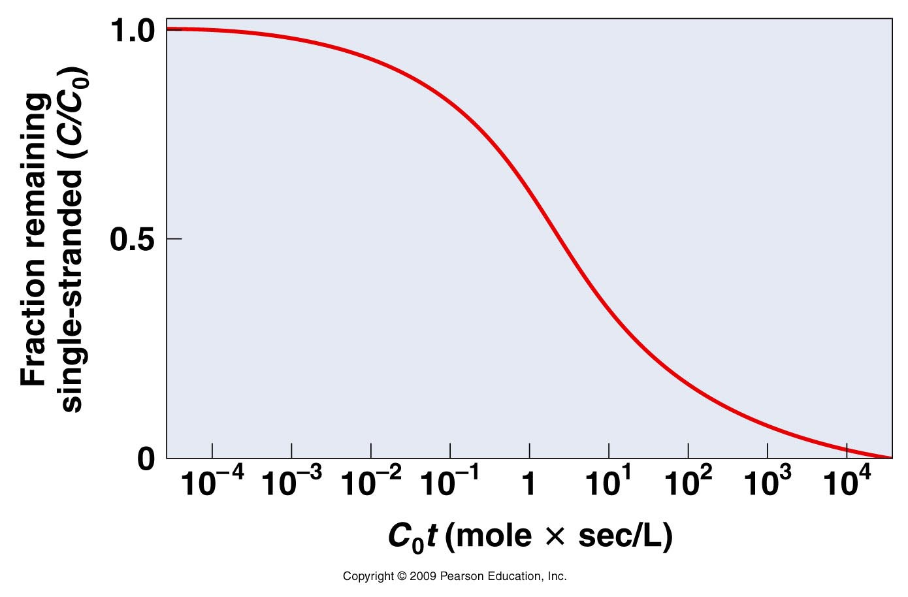
REASSOCIATION KINETICS PROVIDES INFORMATION ABOUT THE SIZE AND COMPLEXITY OF GENOMIC DNA FROM AN ORGANISM
THE IDEAL TIME COURSE FOR REASSOCIATION OF DNA WHEN, AT TIME ZERO, ALL DNA CONSISTS OF UNIQUE FRAGMENTS OF SINGLE-STRANDED COMPLEMENTS

Slide 62
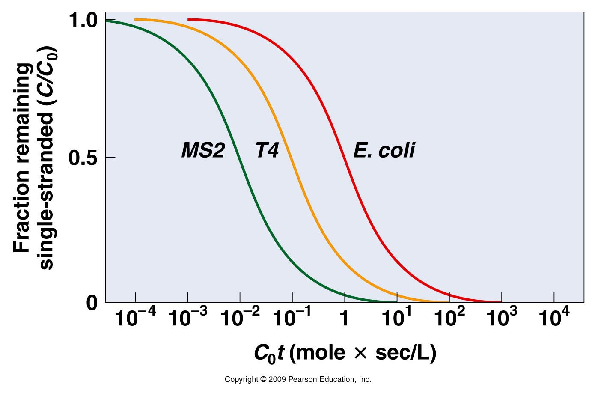

Slide 63
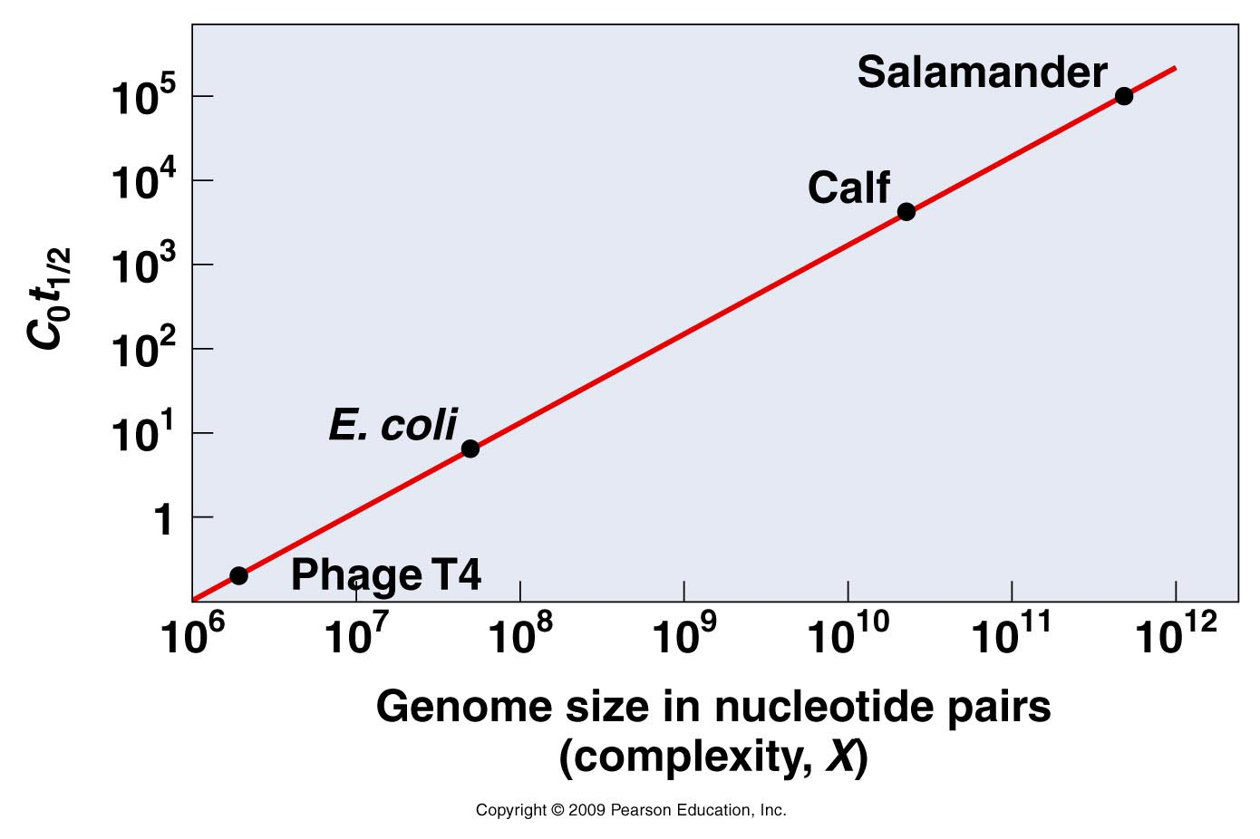
COMPARISON OF AND GENOME SIZE FOR PHAGE T4, E.coli, CALF AND SALAMANDER
Notes:
Figure 10.25

Slide 64
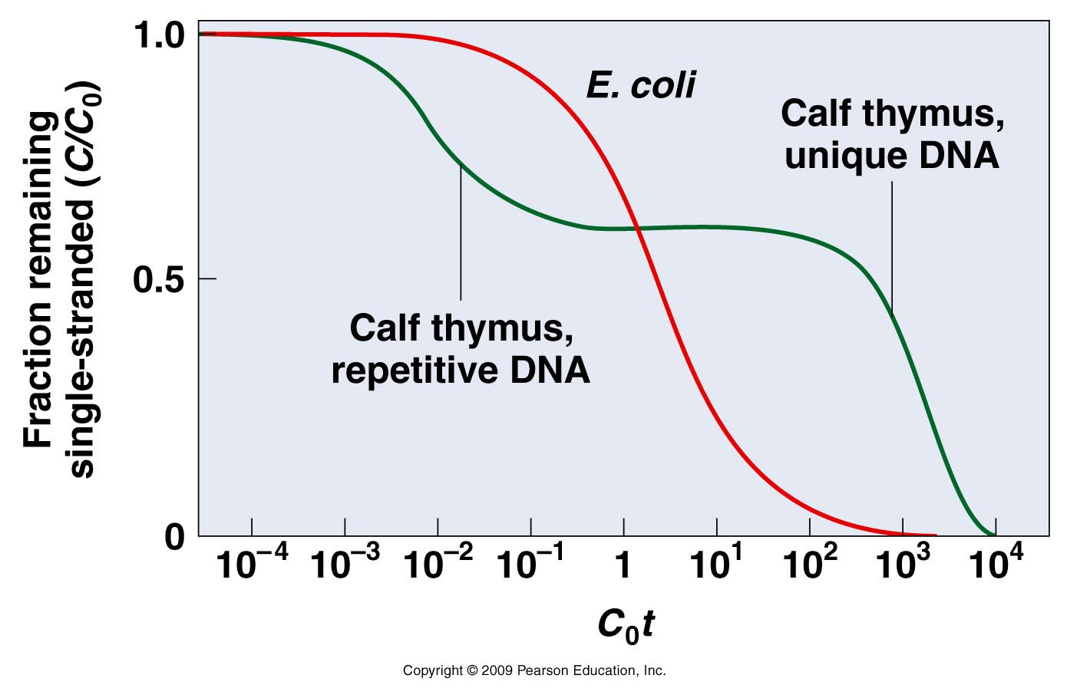
THE CURVE OF CALF THYMUS DNA COMPARED WITH E.coli.
THE REPETITIVE FRACTION OF CALF DNA REASSOCIATES MORE QUICKLY THAN THAT OF E.coli, WHILE THE MORE COMPLEX UNIQUE CALF DNA TAKES LONGER TO REASSOCIATE THAN THAT OF E.coli.

Slide 65
Nucleic acid electrophoresis separates
DNA and RNA fragments by size such that
smaller fragments migrate through a gel at a
faster rate than large fragments

Slide 66
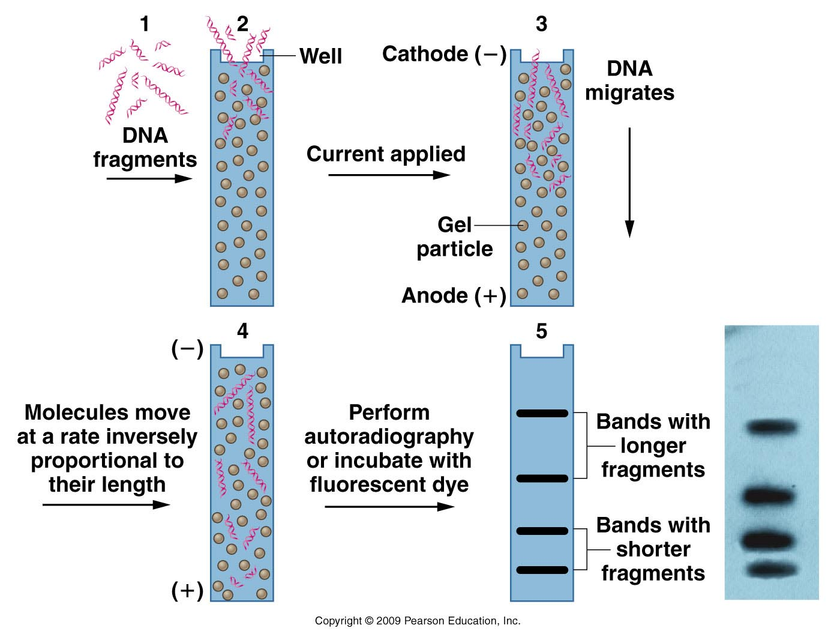
Figure 10.27

Slide 67
ARAŞTIRMA ÖDEVİ
ELEKTROFOREZ YÖNTEMİ,
ÇEŞİTLERİ, KULLANIM ALANLARI
HAKKINDA DETAYLI BİLGİ BULARAK
YAZINIZ

