Slide 1
TRANSCRIPTION

Slide 2
A MESSENGER RNA (mRNA) BEING MADE ON A DNA TEMPLATE WHICH DIRECTS THE SYNTHESIS OF SPECIFIC PROTEINS IN ASSOCIATION WITH RIBOSOMES

Slide 3
THE GENETIC CODE IS:
1. WRITTEN IN LINEAR FORM
2. RNA DERIVED FROM COMPLEMENTARY BASES IN DNA
3. IN mRNA, TRIPLET CODONS SPECIFY 1 AMINO ACID
4. CODE CONTAINS “START” AND “STOP” SIGNALS
5. UNAMBIGUOUS- EACH TRIPLET SPECIFIES ONLY A SINGLE AMINO ACID

Slide 4
THE GENETIC CODE IS:
6. DEGENERATE-A GIVEN AMINO ACID CAN BE SPECIFIED BY MORE THAN ONE TRIPLET CODON
7. COMMALESS-NO INTERNAL BREAKS USED IN THE CODE
8. NON-OVERLAPPING-ANY SINGLE RIBONUCLEOTIDE WITHIN THE mRNA IS PART OF ONLY ONE TRIPLET
9. NEARLY UNIVERSAL-WITH MINOR EXPECTIONS SINGLE CODING DICTIONARY IS USED BY ALL ORGANISMS

Slide 5
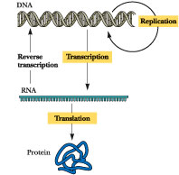

Slide 6
GENETIC CODE IS DEGENERATE,
MANY AMINO ACIDS SPECIFIED BY MORE THAN
ONE CODON
ONLY TRYPTOPHAN AND METHIONINE ARE
ENCODED BY A SINGLE CODON
THE GENETIC CODE SHOWS AN ORDER IN
THAT CHEMICALLY SIMILAR AMINO ACIDS OFTEN
SHARE ONE OR TWO MIDDLE BASES IN THE
TRIPLETS ENCODING THEM

Slide 8
INITIATOR CODON “AUG” IS THE ONLY CODON TO
ENCODE FOR METHIONINE
WHEN AUG APPEARS INTERNALLY IN mRNA,
METHIONINE IS INSERTED INTO THE PROTEIN
IN BACTERIA THE INITIAL AMINO ACID
INCORPORATED INTO ALL PROTEINS IS A MODIFIED
FORM OF METHIONINE-N-formylmethionine (fmet)
THREE CODONS (UAG, UAA, AND UGA) SERVE AS
TERMINATION CODONS AND DO NOT CODE FOR
ANY AMINO ACID

Slide 9
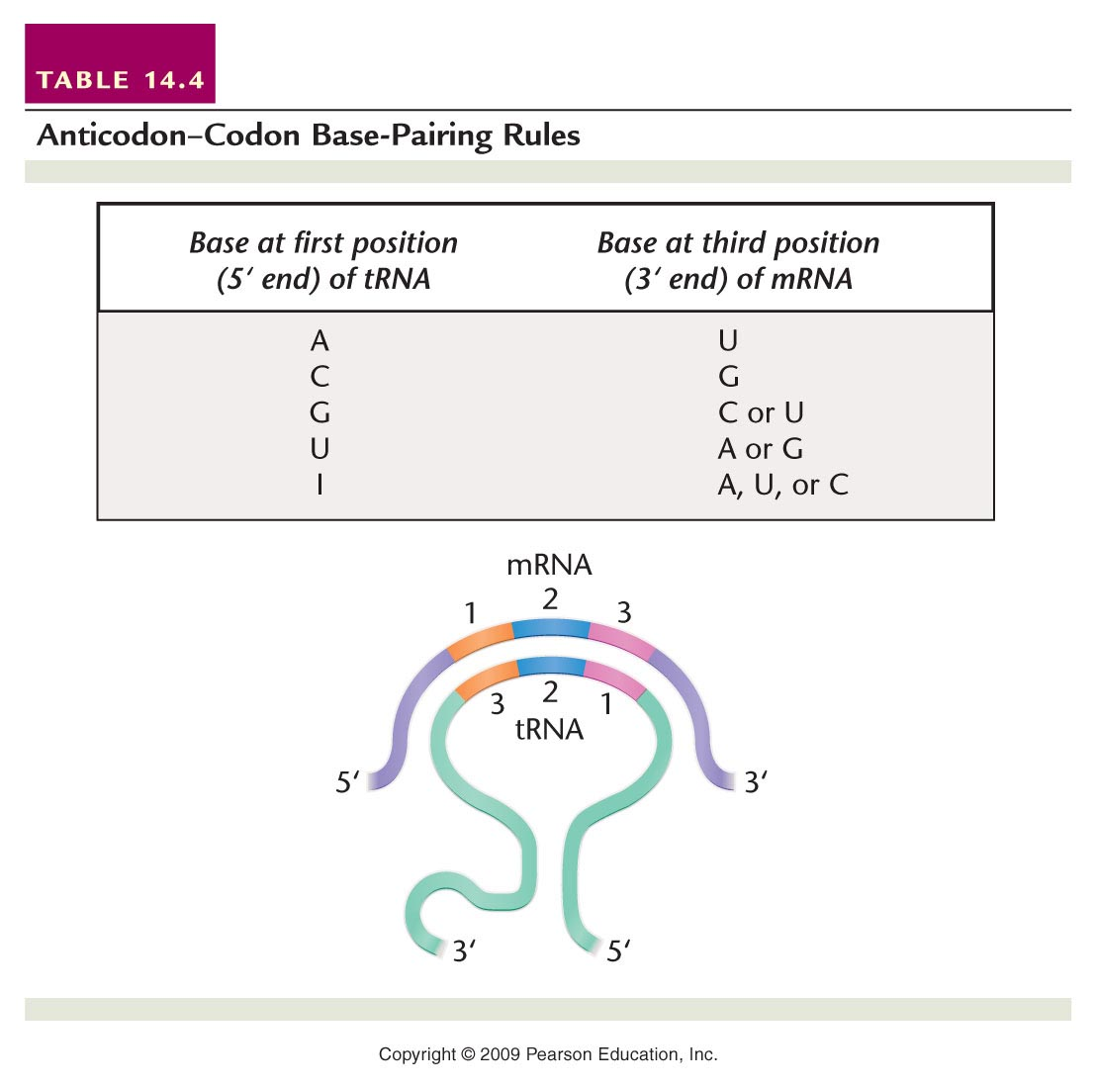
WOBBLE HYPOTHESIS
PREDICTS THAT
HYDROGEN
BONDING BETWEEN
THE CODON AND
ANTICODON
AT THE THIRD
POSITION IS
SUBJECT TO
MODIFIED
BASE-PAIRING
RULES

Slide 10
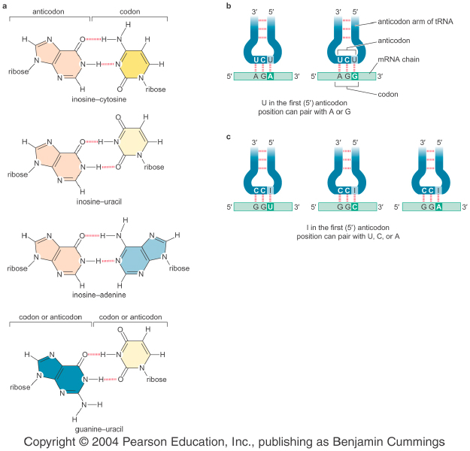
tRNA(1st) mRNA(3rd)
A U
C G
G C,U
U A,G
I A,U,G

Slide 11
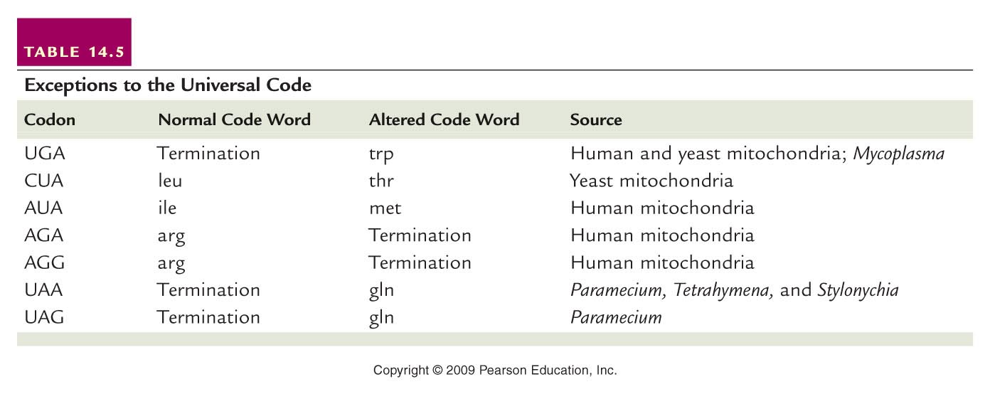
THE GENETIC CODE IS NEARLY UNIVERSAL
MITOCHONDRIAL DNA REVEALED SOME
EXCEPTIONS TO THE UNIVERSAL GENETIC
CODE

Slide 12
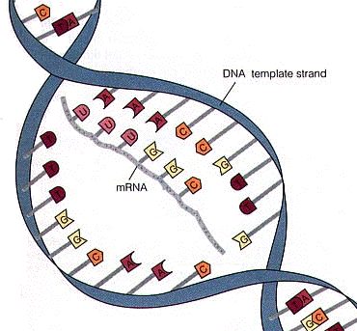
mRNA SERVES AS THE INTERMEDIATE
MOLECULE BETWEEN DNA AND PROTEINS
mRNA IS SYNTHESIZED ON A DNA TEMPLATE
DURING TRANSCRIPTION

Slide 13
TRANSCRIPTION

Slide 15
RNA POLYMERASE DIRECTS THE SYNTHESIS
OF RNA USING A DNA TEMPLATE
RNA POLYMERASE HAS SOME EXCEPTIONS;
* THE SUBSTRATE NUCLEOTIDES CONTAIN
THE RIBOSE RATHER THAN THE
DEOXYRIBOSE FORM OF THE SUGAR
* UNLIKE DNA POLYMERASE, NO PRIMER IS
REQUIRED TO INITIATE SYNTHESIS

Slide 16
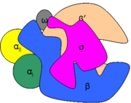
RNA POLYMERASE
RNA POLYMERASE FROM E. coli HAS BEEN
EXTENSIVELY CHARACTERIZED AND SHOWN TO
CONSIST OF SUBUNITS DESIGNATED α, β, β’, ω AND σ
THE COMPLEX, ACTIVE FORM OF THE ENZYME, THE
HOLOENZYME,CONTAINS THE SUBUNITS α₂, β, β’AND σ
AND HAS A MOLECULAR WEIGHT OF ALMOST 500,000 Da
OF THESE SUBUNITS, IT IS THE β and β’, POLYPEPTIDES
THAT PROVIDE THE CATALYTIC MECHANISM AND ACTIVE
SITE FOR TRANSCRIPTION

Slide 17
RNA POLYMERASE
THE σ (sigma) FACTOR PLAYS A REGULATORY
FUNCTION IN THE INITIATION OF RNA
TRANSCRIPTION
EUKARYOTES DISPLAY THREE DISTINCT
FORMS OF RNA POLYMERASE, EACH
CONSISTING OF GREATER NUMBER OF
POLYPEPTIDE SUBUNITS THAN IN BACTERIA

Slide 18
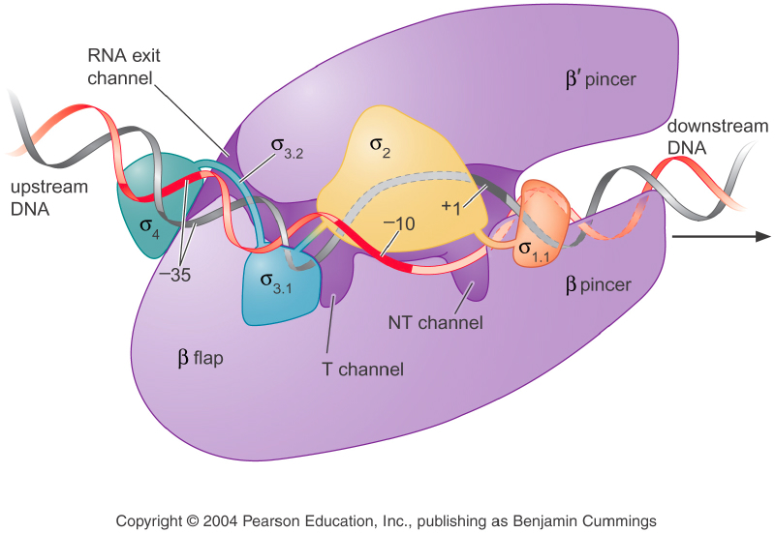

Slide 19
PROMOTERS, TEMPLATE BINDING AND SIGMA SUBUNIT
THE RNA POLYMERASE SIGMA (σ) SUBUNIT
RECOGNIZES SPECIFIC DNA SEQUENCES
CALLED PROMOTERS
THESE SEQUENCES ARE LOCATED IN THE 5’
REGION, UPSTREAM FROM THE POINT OF
INITIAL TRANSCRIPTION OF A GENE

Slide 20
WHEN THE ENZYME ENCOUNTERS A PROMOTER
REGION AND BINDS THERE TO ABOUT 60 NUCLEOTIDE
PAIRS ALONG THE HELIX, 40 OF WHICH ARE UPSTREAM
FROM THE POINT OF INITIAL TRANSCRIPTION
ONCE THIS OCCURS, THE HELIX IS DENATURED
OR UNWOUND, LOCALLY, MAKING THE TEMPLATE
STRAND OF THE DNA ACCESSIBLE TO THE ACTION
OF THE ENZYME
THE POINT AT WHICH TRANSCRIPTION ACTUALLY
BEGINS IS CALLED THE TRANSCRIPTION START
SITE

Slide 21
TWO CONSENSUS SEQUENCES HAVE
BEEN FOUND IN BACTERIAL PROMOTERS:
1. -TATAAT- WHICH IS LOCATED 10 NUCLEOTIDES UPSTREAM FROM THE SİTE OF INITIAL TRANSCRIPTION
(THE -10 REGION OR PRIBNOW BOX)
2. -TTGACA- IS LOCATED 35 NUCLEOTIDES UPSTREAM (THE -35 REGION)
MUTATIONS IN EITHER REGION DIMINISH
TRANSCRIPTION

Slide 22
CONSENSUS SEQUENCES ARE SIMILAR
(HOMOLOGOUS) IN DIFFERENT GENES OF
THE SAME ORGANISM OR IN ONE OR MORE
GENES OF RELATED ORGANISMS
THEIR CONSERVATION DURING EVOLUTION
ATTESTS TO THE CRITICAL NATURE OF THEIR
ROLE IN BIOLOGICAL PROCESSES

Slide 23
SEQUENCES WHICH ARE LOCATED IN THE
REGIONS ADJACENT TO THE GENE ITSELF
ARE NAMED AS CIS-ACTING ELEMENTS
IN MOLECULAR GENETICS, CIS-ELEMENTS ARE
ADJACENT PARTS OF THE SAME DNA MOLECULE
IN CONTRAST, TRANS-ACTING FACTORS ARE
MOLECULES THAT BIND TO THESE DNA
ELEMENTS

Slide 24
IN MOST EUKARYOTIC GENES STUDIED,
A CONSENSUS SEQUENCE COMPARABLE TO
THAT IN THE -10 REGION HAS BEEN
RECOGNIZED
IT IS RICH IN ADENINE ANDITHYMINE RESIDUES,
IT IS CALLED THE TATA BOX

Slide 25
THE DEGREE OF RNA POLYMERASE BINDING
TO DIFFERENT PROMOTERS VARIES GREATLY,
CAUSING VARIABLE GENE EXPRESSION
IN BACTERIA, BOTH STRONG PROMOTERS
AND WEAK PROMOTERS HAVE BEEN
DISCOVERED
Ex:VARIATION IN TIME OF INITIATION FROM ONCE EVERY 1 TO 2 SECONDS TO ONCE EVERY 10 TO 20 MINUTES

Slide 26
PROMOTER EFFICIENCY IS ASSOCIATED WITH THE
σ (sigma) SUBUNIT OF RNA POLYMERASE
THE MAJOR FORM WHICH PROMOTERS OF MOST
BACTERIAL GENES RECOGNIZE IS THE σ⁷⁰ (MW 70 kDa)
SEVERAL ALTERNATIVE FORMS OF RNA POLYMERASE
IN E. coli HAVE UNIQUE σ SUBUNITS ASSOCIATED WITH
THEM (ex: σ³⁴, σ⁵⁴, σ^{S} AND σ^{E})
EACH FORM RECOGNIZES DIFFERENT PROMOTER
SEQUENCES, WHICH IN TURN PROVIDES
SPECIFICITY TO THE INITIATION OF TRANSCRIPTION

Slide 27
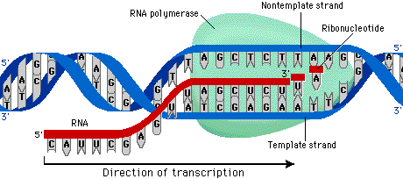

Slide 28
INITIATION, ELONGATION AND TERMINATION OF RNA SYNTHESIS
RNA POLYMERASE CATALYZES INITIATION, THE
INSERTION OF THE FIRST 5-RIBONUCLEOSIDE
TRIPHOSPHATE, WHICH IS COMPLEMENTARY TO
THE FIRST NUCLEOTIDE AT THE START SITE OF
THE DNA TEMPLATE STRAND
SUBSEQUENT RIBONUCLEOTIDE COMPLEMENTS
ARE INSERTED AND LINKED TOGETHER BY
PHOSPHODIESTER BONDS AS RNA
POLYMERIZATION PROCEEDS (5 TO 3 DIRECTION)

Slide 29
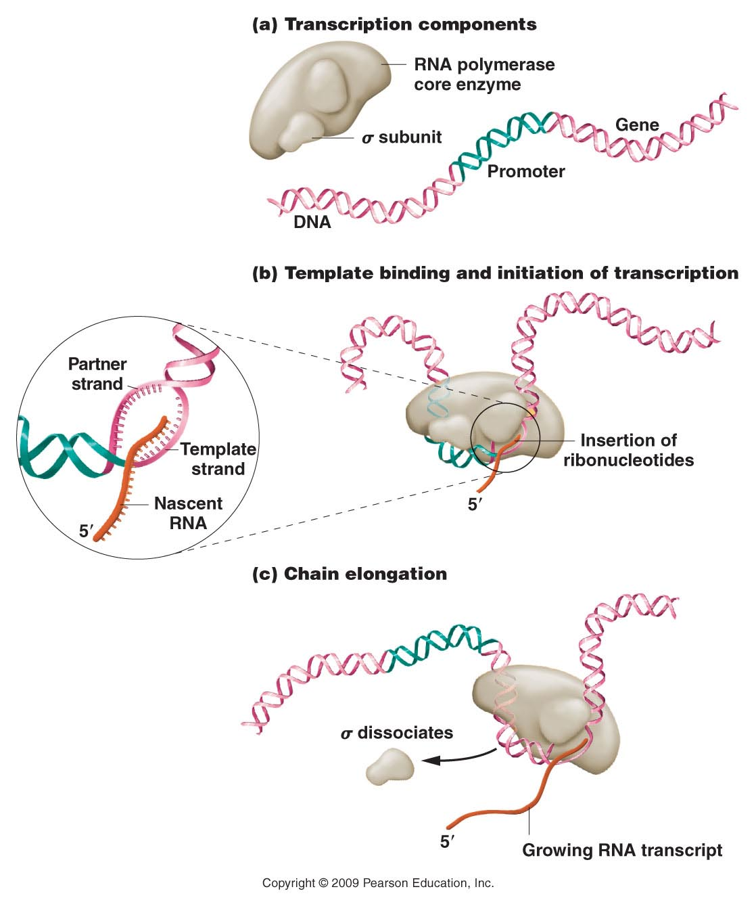
ONCE INITIATION
HAS BEEN
COMPLETED WITH
THE SYNTHESIS OF
THE FIRST 8–9
NUCLEOTIDES,
SIGMA (σ)
DISSOCIATES AND
ELONGATION
PROCEEDS WITH
THE CORE ENZYME

Slide 30
THE ENZYME TRAVERSES THE ENTIRE GENE
UNTIL IT ENCOUNTERS A SPECIFIC NUCLEOTIDE
SEQUENCE THAT ACTS AS A TERMINATION SIGNAL
(40 bp LONG)
THE UNIQUE SEQUENCE OF NUCLEOTIDES IN THIS
TERMINATION REGION CAUSES THE NEWLY
FORMED TRANSCRIPT TO FOLD BACK ON ITSELF,
FORMING A HAIRPIN SECONDARY STRUCTURE,
HELD TOGETHER BY HYDROGEN BONDS
IN SOME CASES, TERMINATION DEPENDS ON
THE RHO (ρ) TERMINATION FACTOR

Slide 31
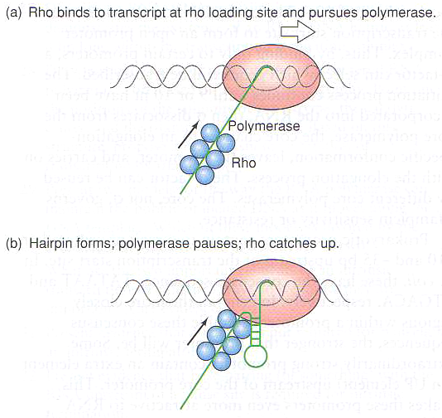
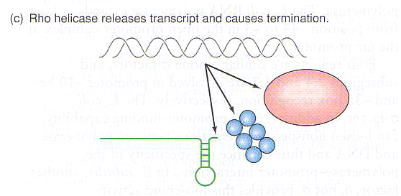

Slide 32
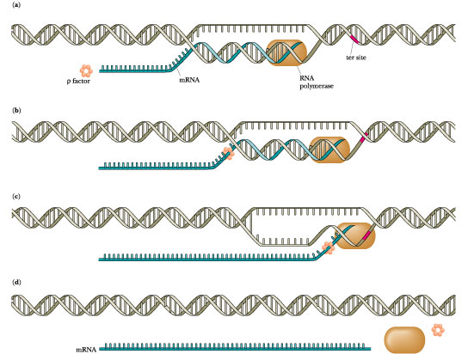

Slide 33
THE SYNTHESIZED RNA MOLECULE IS PRECISELY
COMPLEMENTARY TO THE DNA SEQUENCE OF
THE TEMPLATE STRAND OF THE GENE
WHEREVER AN A, T, C, OR G RESIDUE WAS
ENCOUNTERED THERE, A CORRESPONDING
U, A, G, OR C RESIDUE, RESPECTIVELY, WAS
INCORPORATED INTO THE RNA MOLECULE

Slide 34
GENES IN BACTERIA ARE SOMETIMES CALLED
CISTRONS, THE mRNA IS CALLED A POLYCISTRONIC
mRNA
THE PRODUCTS OF GENES TRANSCRIBED IN THIS
FASHION ARE USUALLY NEEDED BY THE CELL AT
THE SAME TIME
IN EUKARYOTES, MONOCISTRONIC mRNAs ARE THE
RULE

Slide 35
TRANSCRIPTION IN EUKARYOTES DIFFERS
FROM PROKARYOTIC TRANSCRIPTION IN
SEVERAL WAYS
OCCURS IN NUCLEUS AND IS NOT COUPLED TO
TRANSLATION
REQUIRES CHROMATIN REMODELING
IN ADDITION TO PROMOTERS, ENHANCERS ALSO
INFLUENCE TRANSCRIPTION REGULATION
EUKARYOTIC mRNAs REQUIRE PROCESSING TO
PRODUCE MATURE mRNAs

Slide 36
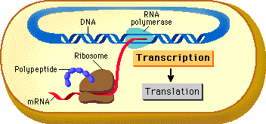
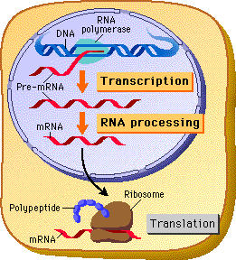

Slide 37
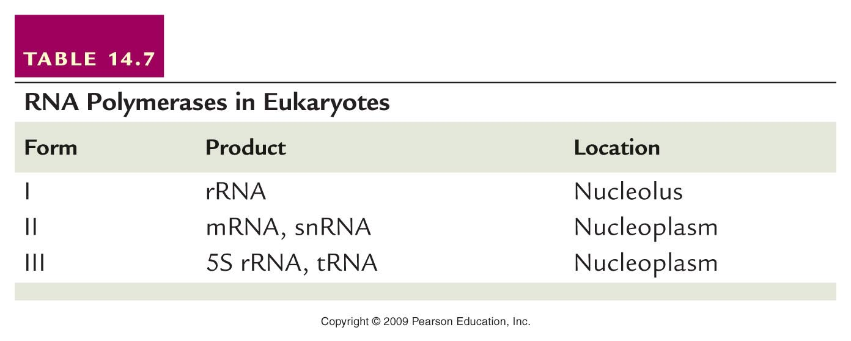
EUKARYOTES POSSESS THREE FORMS OF RNA POLYMERASE EACH OF WHICH TRANSCRIBES DIFFERENT TYPES OF GENES
Notes:
Table 13-7 RNA Polymerases in Eukaryotes

Slide 38
RNA POLYMERASE II (RNP II) IS THE ENYZME
RESPONSIBLE FOR THE PRODUCTION OF ALL
mRNAs IN EUKARYOTES
THE ACTIVITY OF RNP II IS DEPENDENT UPON
BOTH CIS-ACTING ELEMENTS IN THE GENE ITSELF
AND A NUMBER OF TRANS ACTING TRANSCRIPTION
FACTORS THAT BIND TO THESE DNA ELEMENTS

Slide 39
AT LEAST THREE CIS-ACTING DNA ELEMENTS
REGULATE THE INITIATION OF TRANSCRIPTION BY RNP II
THE FIRST OF THESE SEQUENCES, CALLED A
CORE-PROMOTER ELEMENT DETERMINES WHERE
RNP II BINDS TO THE DNA AND WHERE IT BEGINS
COPYING THE DNA INTO RNA
THE OTHER TWO TYPES OF REGULATORY DNA
SEQUENCES: PROMOTER AND ENHANCER ELEMENTS
THEY INFLUENCE THE EFFICIENCY OR THE RATE OF
TRANSCRIPTION BY RNP II AS THE PROCESS PROCEEDS
FROM THE CORE PROMOTER ELEMENT

Slide 40
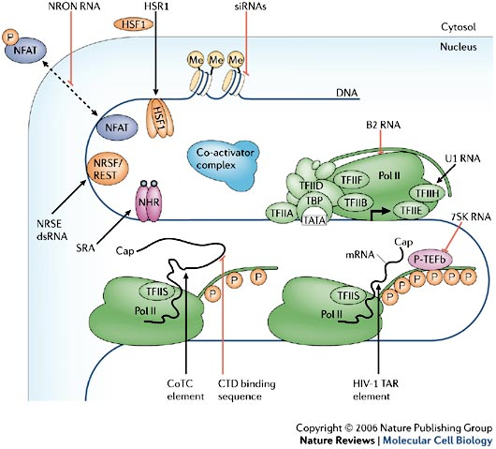

Slide 41
IN MOST OF THE GENES THE CIS-ACTING
CORE-PROMOTER ELEMENT IS THE
GOLDBERG–HOGNESS OR TATA BOX
PRESENT IN ALMOST ALL EUKARYOTIC GENES
LOCATED ABOUT 35 NUCLEOTIDE PAIRS UPSTREAM
(-35) FROM THE START POINT OF TRANSCRIPTION
THE TATA BOXES SHARE A CONSENSUS SEQUENCE
-TATAAAA-

Slide 42
TATA BOX
THE SEQUENCE AND FUNCTION ARE ANALOGOUS TO
THAT FOUND IN THE -10 PROMOTER REGION OF
PROKARYOTIC GENES
BECAUSE THIS REGION IS COMMON TO MOST
EUKARYOTIC GENES, THE TATA BOX IS THOUGHT TO BE
NONSPECIFIC AND TO BE RESPONSIBLE ONLY FOR
FIXING THE SITE OF TRANSCRIPTION INITIATION BY
FACILITATING DENATURATION OF THE HELIX
(A=T BASE PAIRS ARE LESS STABLE THAN G≡C PAIRS)

Slide 43
ANOTHER CIS-ACTING DNA SEQUENCE IS THE
CAAT BOX
THIS CONSENSUS SEQUENCE “GGCCAATCT” IS
LOCATED UPSTREAM (IN THE 5 REGION) OF THE
GENE AT ABOUT 80 NUCLEOTIDES FROM THE
START OF TRANSCRIPTION (-80)
OTHER UPSTREAM REGULATORY REGIONS HAVE
BEEN FOUND AND MOST GENES CONTAIN ONE OR
MORE OF THEM THEY INFLUENCE THE EFFICIENCY
OF THE PROMOTER, ALONG WITH THE TATA BOX
AND CAAT BOX

Slide 44
DNA REGIONS CALLED ENHANCERS
REPRESENT ANOTHER CIS-ACTING ELEMENT
ALTHOUGH THEIR LOCATIONS CAN VARY,
ENHANCERS ARE OFTEN FOUND FURTHER
UPSTREAM THAN THE REGIONS ALREADY
MENTIONED, OR EVEN DOWNSTREAM OR
WITHIN THE GENE

Slide 45
TRANS-ACTING FACTORS ARE OTHER TYPE OF
REGULATORY SEQUENCES THAT FACILITATE
RNPII BINDING (THE INITIATION OF TRANSCRIPTION)
THESE ARE PROTEINS REFERRED TO AS TRANSCRIPTION FACTORS
THERE ARE TWO BROAD CATEGORIES OF
TRANSCRIPTION FACTORS:
THE GENERAL TRANSCRIPTION FACTORS THAT ARE ABSOLUTELY REQUIRED FOR ALL RNP II–MEDIATED TRANSCRIPTION
THE SPECIFIC TRANSCRIPTION FACTORS THAT INFLUENCE THE EFFICIENCY AND THE RATE OF RNPII MEDIATED TRANSCRIPTION

Slide 46
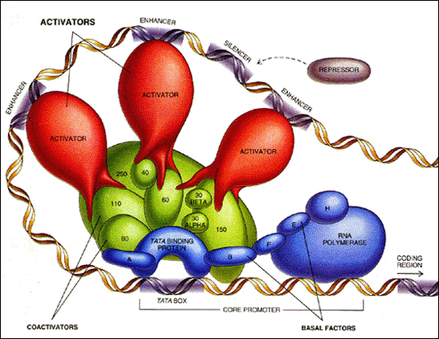

Slide 47
THE GENERAL TRANSCRIPTION FACTORS ARE ESSENTIAL BECAUSE
RNA POLYMERASE II CANNOT BIND DIRECTLY TO EUKARYOTIC
PROMOTER SITES AND INITIATE TRANSCRIPTION WITHOUT THEIR
PRESENCE
THE GENERAL TRANSCRIPTION FACTORS INVOLVED WITH HUMAN
RNPII ARE WELL CHARACTERIZED AND NAMED AS TFIIA, TFIIB, AND
SO ON….
ONE OF THESE, TFIID, BINDS DIRECTLY TO THE TATA-BOX
SEQUENCE TFIID CONSISTS OF ABOUT 10 POLYPEPTİDE SUBUNITS,
ONE OF WHICH IS SOMETIMES CALLED THE TATA-BINDING PROTEIN
(TBP)
ONCE INITIAL BINDING TO DNA OCCURS, AT LEAST SEVEN OTHER
GENERAL TRANSCRIPTION FACTORS BIND SEQUENTIALLY TO TFIID,
FORMING AN EXTENSIVE PRE-INITIATION COMPLEX, WHICH IS THEN
BOUND BY RNA POLYMERASE II

Slide 48
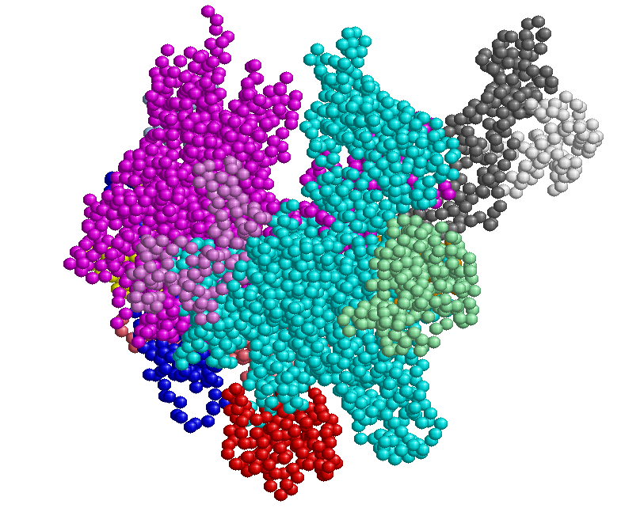
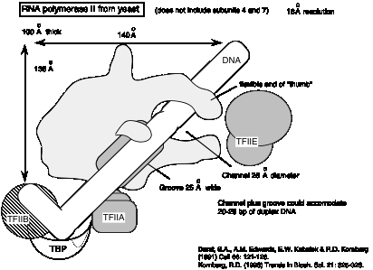
KORNBERG,
FOUND OUT THAT RNA
POLYMERASE II IN
YEAST CONTAINS
TWO LARGE
SUBUNITS AND TEN
SMALLER ONES,
FORMING A HUGE
THREE DIMENSIONAL
COMPLEX WITH A
MOLECULAR WEIGHT
OF ABOUT 500 kDa.

Slide 49
IN BACTERIA, THE RELATIONSHIP BETWEEN DNA
AND mRNA APPEARS TO BE QUITE DIRECT
THE DNA BASE SEQUENCE IS TRANSCRIBED INTO
AN mRNA SEQUENCE WHICH IS THEN IMMEDIATELY
TRANSLATED INTO AN AMINO ACID SEQUENCE
ACCORDING TO THE GENETIC CODE
IN EUKARYOTES, BYCONTRAST, THE RNA MUST
UNDERGO SIGNIFICANT PROCESSING BEFORE
BEING TRANSPORTED TO THE CYTOPLASM AS
mRNA TO PARTICIPATE IN TRANSLATION

Slide 50
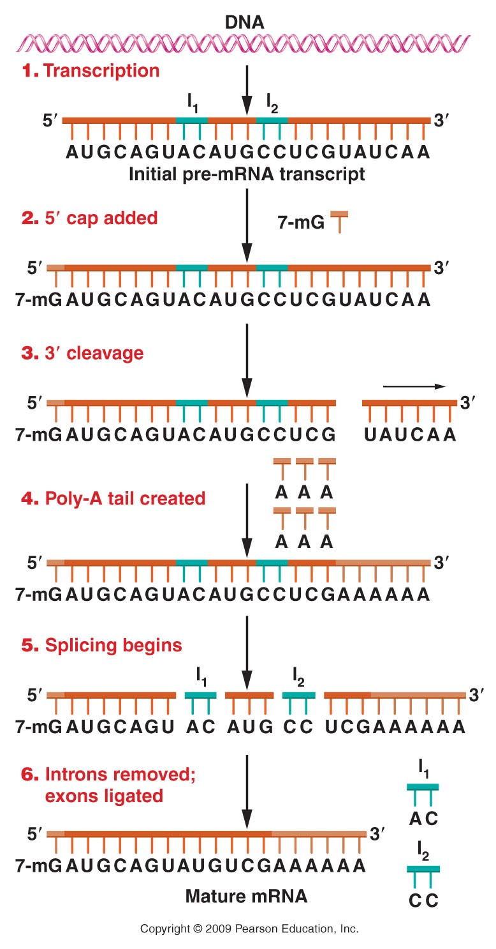
HETEROGENEOUS
NUCLEAR RNA (hnRNA) IS
POSTTRANSCRIPTIONALY
PROCESSED BY THE
ADDITION OF A 5'
7-METHYLGUANOSINE CAP
AND A POLY-A TAIL
INTRONS ARE REMOVED BY
SPLICING
EXONS SPLICED TOGETHER

Slide 51
5’ Cap 7-metilguanozin (7mG)

Slide 52
3’ Kuyruk (tail) Poliadenilasyon (poly A mRNA- AAUAAA )

Slide 53
INTRONS (INTERVENING SEQUENCES) ARE
REGIONS OF THE INITIAL RNA TRANSCRIPT THAT
ARE NOT EXPRESSED IN THE AMINO ACID
SEQUENCE OF THE PROTEIN
INTRONS ARE REMOVED BY SPLICING AND THE
EXONS (EXPRESSED) ARE JOINED TOGETHER IN THE
MATURE mRNA
THE SIZE OF THE MATURE mRNA IS USUALLY MUCH
SMALLER THAN THAT OF THE INITIAL RNA

Slide 54
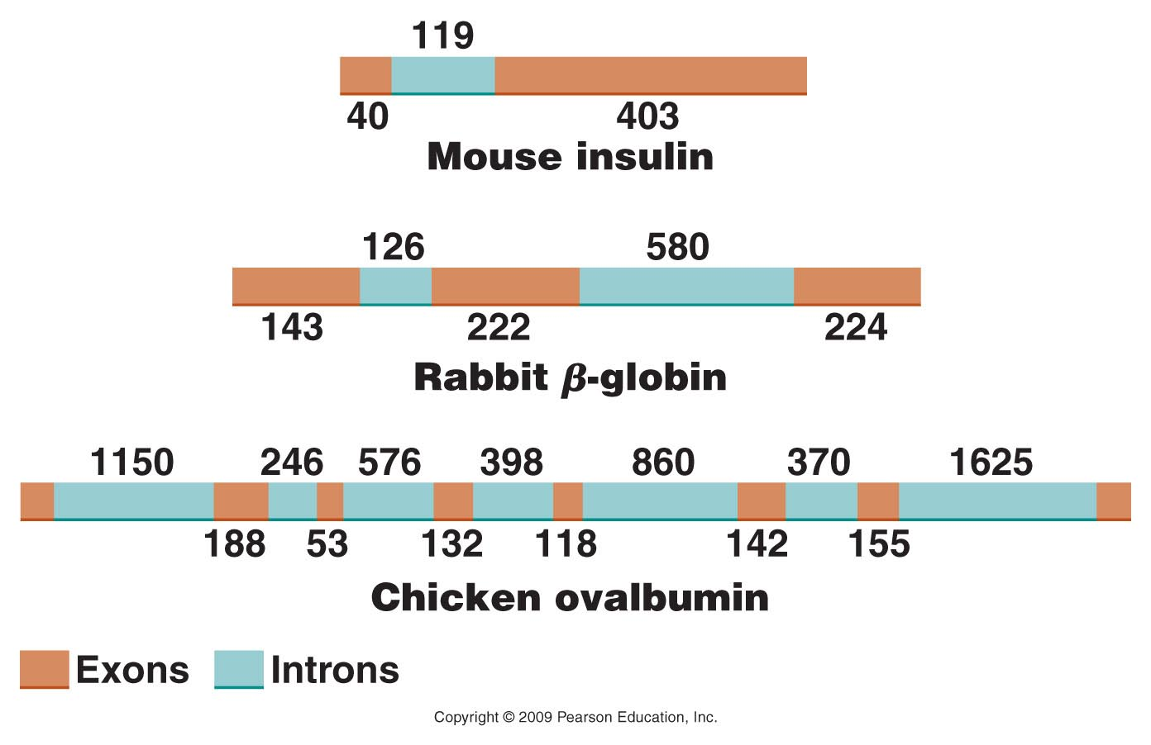

Slide 55
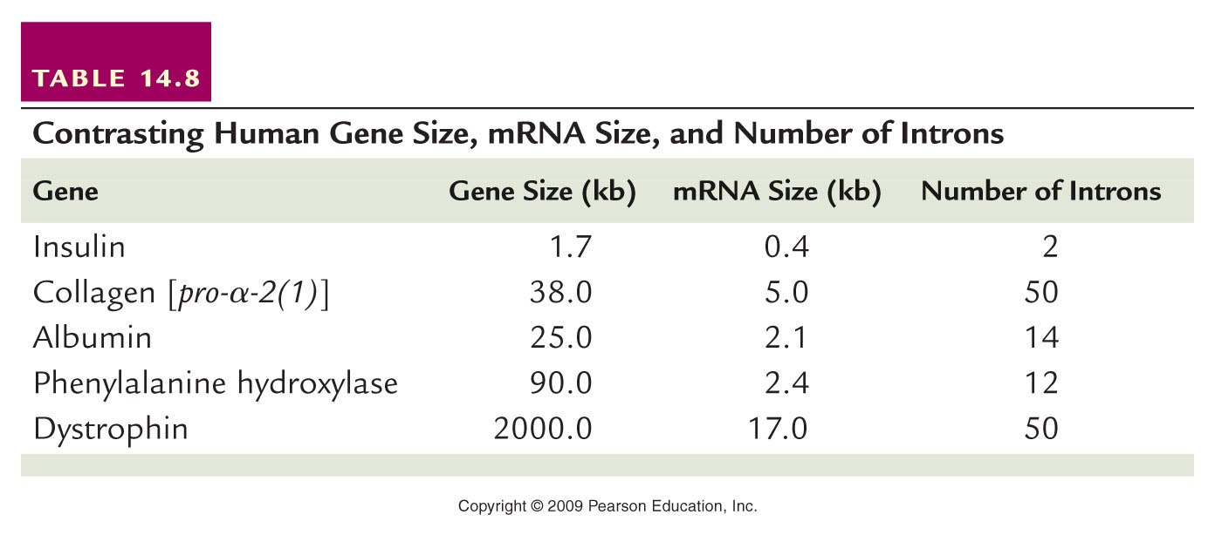

Slide 56
SPLICING MECHANISMS
Introns can be categorized into several
groups based on their splicing mechanisms.
Group I, represented by introns that are part
of the primary transcript of rRNAs, require
no additional components for intron excision;
the intron itself is the source of the
enzymatic activity necessary for removal.
Autocatalytic RNAs

Slide 57
RNAs THAT ARE CAPABLE OF CATALYTIC
ACTIVITY ARE REFERRED TO AS RIBOZYMES
THE AUTOCATALYTIC tRNA CAPABLE OF
SELF-SPLICING AND THUS FUNCTIONING LIKE
AN ENZYME IS AN EXCELLENT

Slide 58
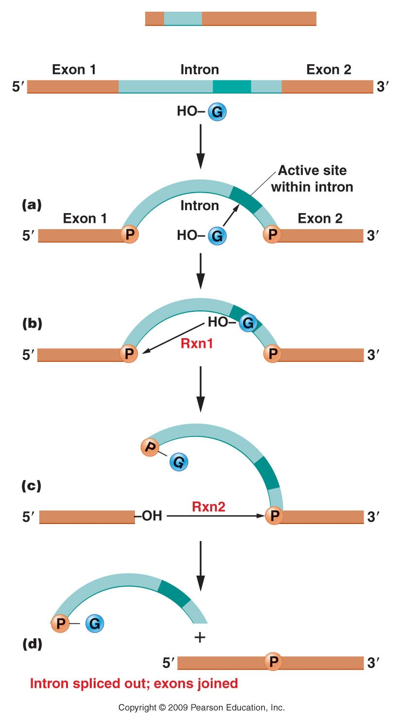
Group 1 Introns
Splicing mechanism involved with group I introns removed from the primary transcript leading to rRNA. The process is one of self-excision involving two trans esterification reactions.
Notes:
Figure 14-13

Slide 59
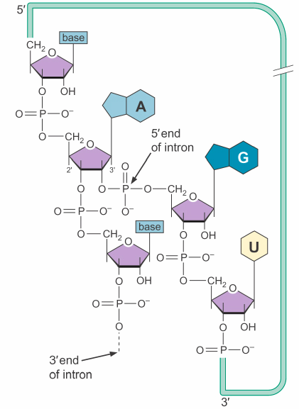
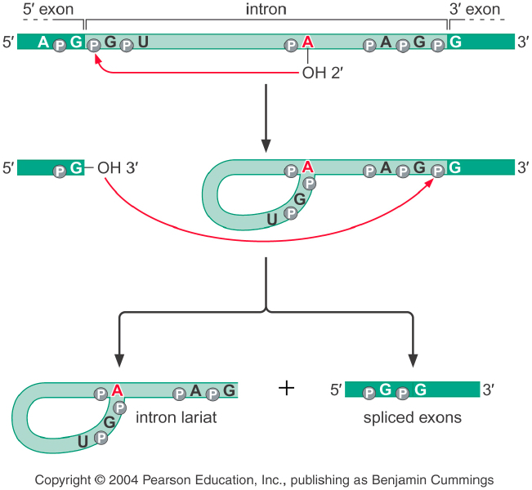

Slide 60
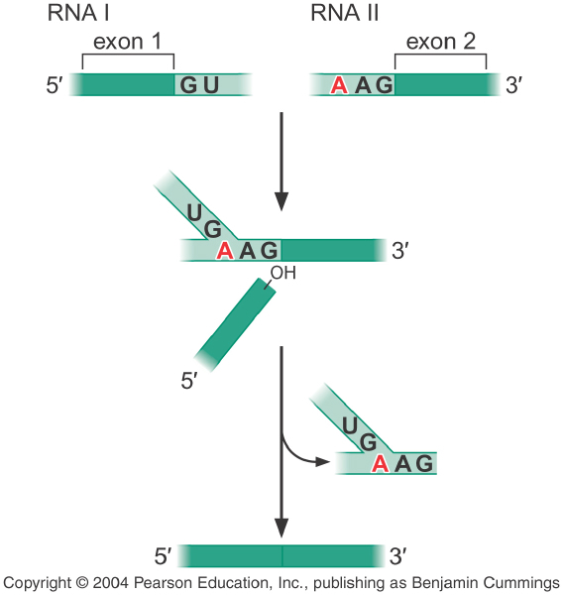

Slide 61
SPLICING MECHANISMS
THE SPLICEOSOME
COMPARED TO THE GROUP I AND GROUP II
INTRONS, INTRONS IN NUCLEAR-DERIVED
mRNA CAN BE MUCH LARGER—UP TO 20,000
NUCLEOTIDES
THEIR REMOVAL APPEARS TO REQUIRE A
MUCH MORE COMPLEX MECHANISMS

Slide 62
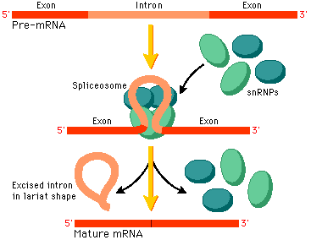

Slide 63
THE NUCLEOTIDE SEQUENCES NEAR THE
ENDS OF THIS TYPE OF INTRONS ARE ALL
IDENTICAL
THEY BEGIN AT THE 5’ END WITH A “GU”
DINUCLEOTIDE SEQUENCE, CALLED THE
DONOR SEQUENCE AND TERMINATE AT THE 3’
END WITH AN “AG” DINUCLEOTIDE, CALLED THE
ACCEPTOR SEQUENCE

Slide 64
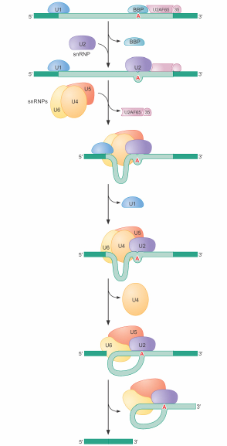

Slide 65
INTRONS ATTRACT SPECIFIC MOLECULES THAT
FORM A MOLECULAR COMPLEX, A SPLICEOSOME,
WHICH IS ESSENTIAL TO THIS FORM OF SPLICING
PRE-mRNA INTRONS ARE SPLICED OUT BY
THE SPLICEOSOME IN A REACTION INVOLVING
THE FORMATION OF LARIAT STRUCTURE

Slide 66
THE MOST ESSENTIAL COMPONENT
OF SPLICEOSOMES IS THE UNIQUE SET OF
SMALL NUCLEAR RNAs (snRNAs)
THESE RNAs ARE USUALLY 100 TO 200
NUCLEOTIDES LONG OR LESS AND ARE OFTEN
COMPLEXED WITH PROTEINS TO FORM
SMALL NUCLEAR RIBONUCLEOPROTEINS
(snRNPs)
THESE ARE FOUND ONLY IN THE NUCLEUS
BECAUSE THEY ARE RICH IN URIDINE RESIDUES,
THE snRNAs HAVE BEEN ARBITRARILY NAMED AS;
U1, U2, . . ., U6.

Slide 67
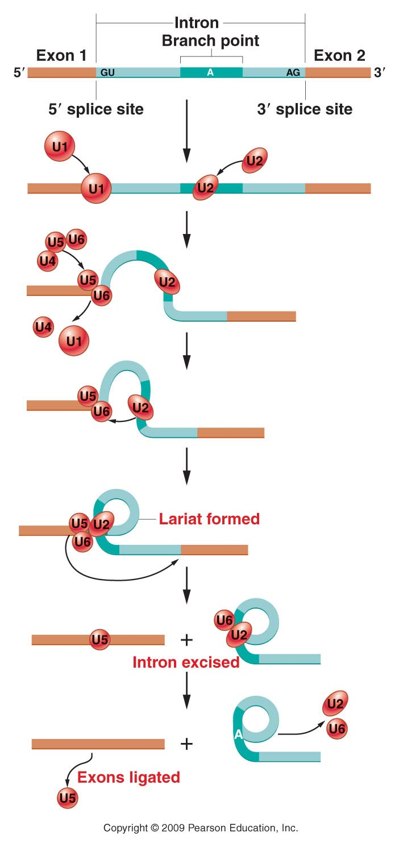

Slide 68
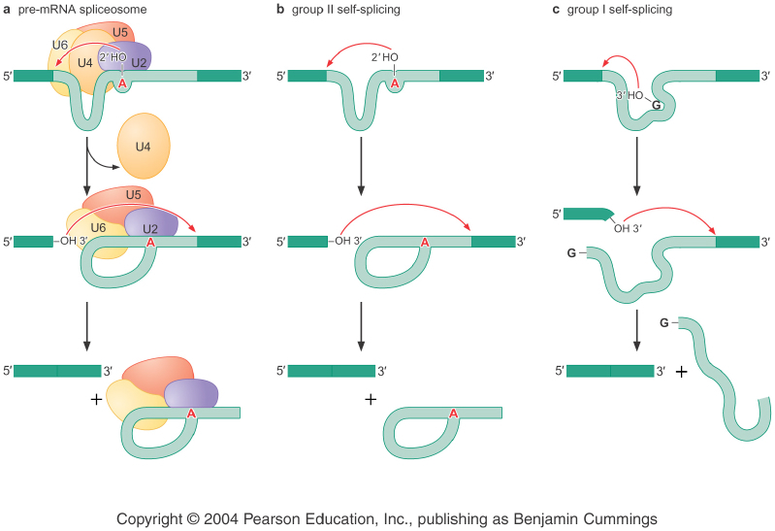

Slide 69
THE PROCESSING INVOLVED IN SPLICING, WHICH
OCCURS WITHIN THE NUCLEUS, REPRESENTS A
POTENTIAL REGULATORY STEP IN GENE EXPRESSION IN
EUKARYOTES
ALTERNATIVE SPLICING YIELDS A GROUP OF SIMILAR
BUT NON-IDENTICAL mRNAS THAT, UPON TRANSLATION,
RESULT IN A SERIES OF RELATED PROTEINS CALLED
ISOFORMS
ALTERNATIVE SPLICING OF PRE-mRNAS REPRESENTS
A WAY OF PRODUCING RELATED PROTEINS FROM A
SINGLE GENE, INCREASING THE NUMBER OF GENE
PRODUCTS THAT CAN BE DERIVED FROM AN ORGANISM’S
GENOME

Slide 70
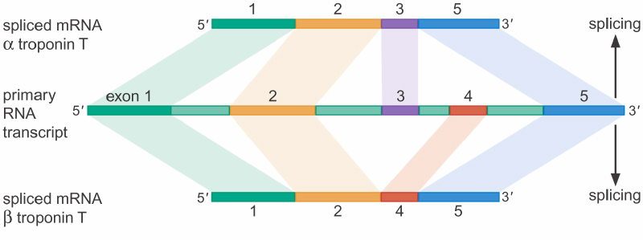

Slide 71
ANOTHER POSTTRANSCRIPTIONAL RNA
PROCESSING WAS DISCOVERED IN SEVERAL
ORGANISMS REFERRED TO AS RNA EDITING
THE NUCLEOTIDE SEQUENCE OF A PRE-mRNA
IS ACTUALLY CHANGED PRIOR TO TRANSLATION

Slide 72
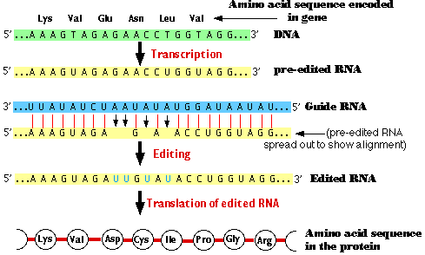

Slide 73
ALTHOUGH OTHER VARIATIONS EXIST, THERE ARE
TWO MAIN TYPES OF RNA EDITING:
SUBSTITUTON EDITING
IN WHICH THE IDENTITIES OF INDIVIDUAL NUCLEOTIDE BASES ARE ALTERED
INSERTION/DELETION EDITING
IN WHICH NUCLEOTIDES ARE ADDED TO OR SUBTRACTED FROM THE TOTAL NUMBER OF BASES (GUIDE RNA-gRNA).

Slide 74
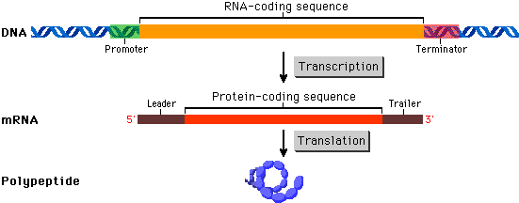

Slide 75
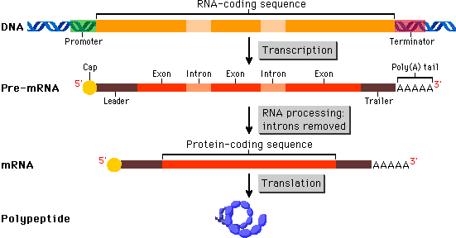

Slide 76
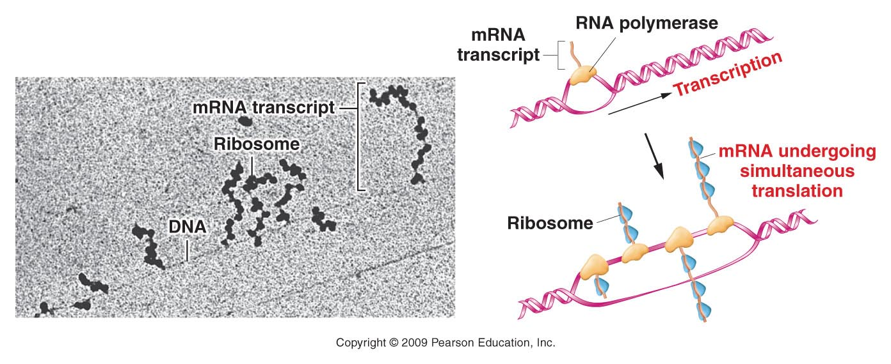
Transcription Has Been Visualized by
Electron Microscopy

Slide 77
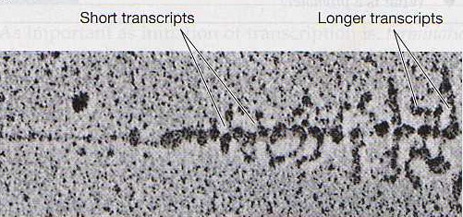

Slide 78
BECAUSE PROKARYOTES LACK NUCLEI,
CYTOPLASMIC RIBOSOMES ARE NOT SEPARATED
PHYSICALLY FROM THE CHROMOSOME
RIBOSOMES ARE FREE TO ATTACH TO PARTIALLY
TRANSCRIBED mRNA MOLECULES AND INITIATE
TRANSLATION
THE LONGER THE RNA STRAND, THE GREATER
THE NUMBER OF RIBOSOMES ATTACHED TO IT
THESE STRUCTURES ARE CALLED POLYRIBOSOMES

